Slide 1
Azure Solution Alignment Workshop
Module 7 – Security
Notes:
For Azure security, we’ll look at:
Azure services and features you can use to help secure your services and data within Azure.
How Microsoft secures the Azure infrastructure to help protect your data and applications.
What are the current recommended practices from Microsoft’s field experiences?

Slide 2
High-level Agenda
Trustworthy Foundation
Assume Breach
Azure Infrastructure Protection
Data Protection
Key Vault
Disk Encryption
SQL Encryption
Security Strategies and Decisions
Next steps

Slide 3
Azure security overview

Slide 4











Built on a trustworthy foundation
Trustworthy
Computing Initiative
1st Microsoft datacenter
Hotmail
UK G-Cloud Level 2
FedRAMP/ FISMA
Malware Protection Center
Active Directory
MSN
SOC 1
SOC 2
1989
1995
2000
2005
2010
Windows Update
Security Development Lifecycle
E.U. Data Protection Directive
CSA Cloud Controls Matrix
Global Data Center
Services
Digital Crimes Unit
ISO/IEC 27001:2005
HIPAA/ HITECH
PCI DSS Level 1
Microsoft Security Response Center
aka.ms/Azure/Trust
Notes:
Microsoft has proven experience delivering cloud services at global scale and uses this deep knowledge to develop best practices and technology innovations that support increased reliability and compliance readiness. Microsoft Trustworthy Computing (TwC) is a long-term, collaborative effort to create and deliver secure, private, and reliable computing experiences for everyone. TwC principles and processes inform every aspect of Microsoft Azure from design to development to operations, helping to deliver a more secure, private, and compliant platform for customers.
Microsoft also engages in industry-leading security efforts through the creation of centers of excellence:
Microsoft Digital Crime Unit (DCU). The DCU brings together a unique team of lawyers, investigators, business professionals, intelligence specialists and forensic analysts – deploys trailblazing techniques to fight a wide array of online criminal activity.
Microsoft Cybercrime Center. An effort of the DCU, the Microsoft Cybercrime is a secured facility at the company’s Redmond campus. It houses groundbreaking Microsoft technologies that allow the team to visualize and identify global cyber threats developing in real time, The Cybercrime Center includes a separate and secure location for third-party partners, allowing cybersecurity experts from around the world to work in the facility with Microsoft experts. With nearly 100 attorneys, investigators, technical experts and forensic analysts based around the world, the Microsoft Cybercrime Center is well positioned to make it safer for people online worldwide.
Microsoft Malware Protection Center (MMPC). By continuously gathering and analyzing data, and by working with organizations inside and outside Microsoft, the MMPC helps combat evolving threats. Labs in Redmond, Washington, U.S.A.; Munich, Germany; Vancouver, Canada; and Melbourne, Australia—with the help of additional researchers in other locations around the world—ensure that a response team is always online.
Microsoft embraces security, privacy, and compliance for its enterprise cloud services as a shared responsibility.
For on-premises applications, you are responsible for the entire technology stack – everything from physical security to OS patching to network security.
We help reduce the security and compliance burden for customers by providing a trusted foundation for your applications, infrastructure and data. For example, Microsoft uses integrated deployment systems to manage the distribution and installation of security updates for the Microsoft Azure service.
Yet we also provide the security capabilities and flexibility you need to use the services in accordance with you own standards. For example, customers can apply similar update management processes for virtual machines (VMs) deployed on Microsoft Azure.

Slide 5


Transparency and independent verification
Aid customers in meeting security and compliance obligations
Third-party verification
Access to audit reports
Compliance packages
Best practices and guidance
Security Response Center progress report
Security intelligence report
Trust Center
Cloud Security Alliance
Notes:
Slide title: Transparency & independent verification: aid customers in meeting security & compliance obligations
Slide objectives: Explain the concept of transparency and independent verification as part of the Microsoft approach
Slide script:
Microsoft is committed to ongoing verification by third party audit firms, and shares audit report findings and compliance packages with customers to help them fulfill their own compliance obligations.
We also publish best practices and prescriptive guidance on securing your data, applications, and infrastructure in Microsoft Azure.
Detailed information about Microsoft Azure security, privacy, and compliance in available in our online Trust Center. This includes a list of current certifications, links to whitepapers, and other detailed information.
Microsoft participates in industry-wide transparency initiatives, especially through its association with the Cloud Security Alliance (CSA). Microsoft publishes information about how it addresses the CSA Cloud Controls Matrix in the publically accessible CSA Security, Trust & Assurance Registry (STAR).
Microsoft publishes reports a Security Response Center Progress report and a Security Intelligence report to provide insight to customers into the threat landscape.
By providing customers with compliant cloud services and detailed information about how it addresses security standards across a range of compliance programs, Microsoft make it easier for customers to achieve compliance for the infrastructure and applications they run in Microsoft Azure.

Slide 6
Tools for implementing secure environments
Microsoft provides various tools and best practices to implement the shared responsibility model, including:
Network protection
Private, isolated network
Extend existing topology
Private, physical connection
Data protection
Data redundancy options
Encryption - in-transit & at-rest
Key Vault
Azure Security Center
Identity and access
Manage user identities
Multi-factor authentication
Role-based access control
We publish a wide range of whitepapers detailing best practices for building secure environments on Azure: http://azure.microsoft.com/en-gb/support/trust-center/resources/
Notes:
NOTE TO PRESENTER. The outer boxes will not be discussed in this deck as there are specific modules for IDENTITY and NETWORKING to cover those areas.
This deck will ONLY focus on the middle box.
PRESENTER PREPARATION TIPS – if you are not already familiar with them, get into the portal and explore Azure Key Vault and Azure Security Center. If possible to do some show and tell particularly in the Azure Security Center, that will help to polish the presentation. Also, always good to revisit the Azure Trust site for the latest guidance as well! https://azure.microsoft.com/en-us/support/trust-center/

Slide 7

Azure Design and Operations
Software Development Lifecycle (SDL)
Operational security controls
Assume breach
Incident response
Security embedded in planning, design, development, and deployment
Rigorous controls to prevent, detect, contain, and respond to threats
Hardening cloud services through simulated real-world attacks
Global, 24x7 incident response to mitigate effects of attacks
Notes:
Slide title: Design & operations
Slide objectives: Provide an overview of Microsoft Azure design & operations.
Slide script:
SDL (Designing for security from the ground up). Microsoft Azure development adheres to the Security Development Lifecycle (SDL). The SDL became central to Microsoft’s development practices a decade ago, and is shared freely with the industry and customers. It embeds security requirements into systems and software through the planning, design, development, and deployment phases.
Operational security controls (Keeping operations safe). Microsoft Azure adheres to a rigorous set of security controls that govern operations and support. The Microsoft Azure team works with other entities within Microsoft such as Office 365 and the Microsoft Operational Security Assurance (OSA) group to identify risks and share information, supporting continuous improvement in operational controls. This increases the ability to prevent, detect, contain, and respond to operational security threats specific to Microsoft Azure and company-wide.
Assume breach (Hardening cloud services). One key operational best practice that Microsoft uses to harden its cloud services is known as the “assume breach” strategy. A dedicated “red team” of software security experts simulates real-world attacks at the network, platform, and application layers, testing Microsoft Azure’s ability to detect, protect against, and recover from breaches. By constantly challenging the security capabilities of the service, Microsoft can stay ahead of emerging threats.
Incident response (mitigating the effects of attacks). Microsoft Azure has a global, 24x7 incident response service that works to mitigate the effects of attacks and malicious activity. The incident response team follows established procedures for incident management, communication, and recovery, and uses discoverable and predictable interfaces internally and to customers.

Slide 8
Security development lifecycle
Education
Process
Accountability
Administer and track security training
Guide product teams to meet SDL requirements
Establish release criteria and sign-off as part of FSR
Incident
Response (MSRC)
Training
Requirements
Design
Implementation
Verification
Release
Response
Ongoing process improvements
Notes:
Slide title: Security development lifecycle
Slide objectives: Provide an overview of the Microsoft SDL.
Slide script:
The Microsoft Security Development Lifecycle (SDL) is a set of processes and tools designed to minimize the number and severity of vulnerabilities in software products. It encompasses education of development personnel, secure development processes, and accountability of individuals and product teams—all for the building of more consistently secure software.
Azure uses the SDL to systematically address security threats throughout the development process: through threat modeling during the design process, following development best practices and code security standards during coding, and requiring the use of various tools for testing and verification before deployment. These proactive checks during development make software less vulnerable to potential threats after release and the SDL provides a structured and consistent methodology through which to apply them. These methodologies, which are supported by an executive commitment to security, have helped Microsoft develop more secure software.

Slide 9
Assume breach
Prevent breach
Threat model
Assume breach identifies & addresses potential gaps
Scope ongoing live site testing of security response plans to drastically improve mean time to detection and recovery
Reduce exposure to internal attack (ensuring once inside, attackers do not have broad access)
Periodic environment post-breach assessment and clean state
Code review
Security testing
Security development lifecycle (SDL)
Assume breach
War game exercises
Live site pentest
Centralized security
logging & monitoring
Notes:
Slide title: Assume breach
Slide objectives: Describe how the Assume Breach strategy helps identify & address significant gaps in detecting attacks & penetration, responding to attacks & penetration, and recovering from data leakage or tampering.
Slide script:
Microsoft takes a two prong approach to threat defense, which they refer to as Prevent Breach and Assume Breach.
Prevent Breach is a defensive strategy aimed at predicting and preventing a security breach before it happens. This involves continuous improvements to built-in security features, including port scanning and remediation, perimeter vulnerability scanning, OS Patching to latest updated security software, network-level DDOS (Distributed Denial of Service) detection & prevention, and multi-factor authentication for service access. Most organizations employ tactics to prevent a breach.
CLICK. The Assume Breach strategy, however, is unique to Microsoft and is is a key operational practice that it uses to harden its cloud services. A dedicated “red team” of software security experts simulates real-world attacks at the network, platform, and application layers. While a “blue team” of experts work to detect, protect against, and recover. This approach focuses on identifying and ejecting attackers, limiting what access an attacker would have if various layers were breached – we do this though techniques like segregation of duties, and how quickly we can restore the environment in the event of a breach. By constantly challenging the security capabilities of the service, Microsoft can stay ahead of emerging threats and be prepared to act quickly to threats.

Slide 10
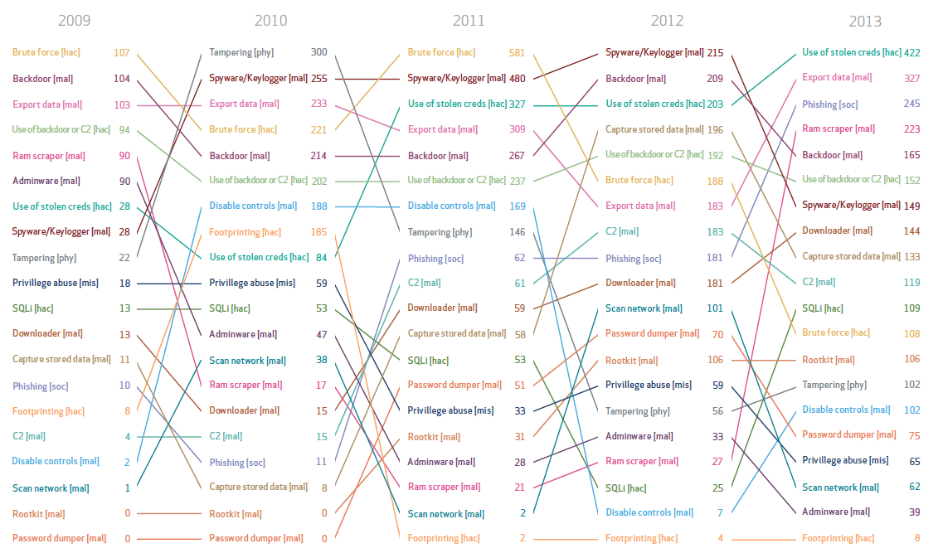

Why adopt an assume breach security strategy?
Top 20 threat actions over time
Attackers adapt and new threats appear year after year.
How can IT keep up with emerging threats?
Verizon Data Breach Investigation Report: http://www.verizonenterprise.com/DBIR/2014/

Slide 11
Red Team vs. Blue Team
The assume breach security strategy is executed by two core groups:
The Red Team – dedicated adversary (a group of ethical hackers) performing targeted and persistent attacks against our Microsoft Online Services (Microsoft’s own properties)
The role of the Red Team is to attack and penetrate environments, using the same steps adversary’s kill chain:
Recon
Delivery
Foothold
Persist
Move
Elevate
Exfiltrate
Key metrics captured when Red Team performs its breaches:
Mean time to compromise (MTTC)
Mean time to privilege escalation or “pwnage” (MTTP)
Microsoft Enterprise Cloud Red Teaming: http://go.microsoft.com/fwlink/?linkid=518599&clcid=0x409

Slide 12
Red Team vs. Blue Team
The Blue Team is comprised of either a dedicated set of security responders, or members from across the security incident response – engineering and operations organizations. Regardless of their makeup, they are independent and operate separately from the Red Team.
When an adversary, such as a Red Team, has breached an environment, the Blue Team must:
Gather
Detect
Alert
Triage
Context
Plan
Execute
Key metrics evaluated by the Blue Team include:
Estimated time to detection (ETTD)
Estimated time to recovery (ETTR)
Microsoft Enterprise Cloud Red Teaming: http://go.microsoft.com/fwlink/?linkid=518599&clcid=0x409

Slide 13
Response evolution
Assumed breach execution cycle
War-game
exercises
Monitor emerging threats
Red
teaming
Execute
post-breach
Insider attack simulation
Blue teaming
Notes:
Red Teaming makes theoretical scenarios real by exposing gaps in security, exploiting live vulnerabilities, and providing concrete evidence of the need to assume breach
This challenging world – the Blue Team exercises the ability to detect and respond in the face of attacks
All organizations can benefit from adopting similar security strategies for combatting emerging and evolving threats

Slide 14

Infrastructure protection
24-hour monitored physical security
Secure multi-tenant environment
Firewalls
Patch management
System monitoring and logging
Antivirus/antimalware protection
Threat detection
Forensics
Notes:
Slide title: Infrastructure protection
Slide objectives: Provide an overview of infrastructure protection with Microsoft Azure.
NOTE: you do NOT need to go in depth here…..each of these are separate slides ahead…
Slide script:
Microsoft Azure infrastructure includes hardware, software, administrative and operations staff, and physical datacenters. Microsoft Azure addresses security risks across its infrastructure with continuous intrusion detection and prevention systems, denial of service attack prevention, regular penetration testing, and forensic tools that help identify and mitigate threats. With Microsoft Azure, customers can reduce the need to invest in these capabilities on their own and benefit from economies of scale in Microsoft datacenter infrastructure.
24-hour monitored physical security. Microsoft datacenters are physically constructed, managed, and monitored 24 hours a day to shelter data and services from unauthorized access as well as environmental threats.
Secure multi-tenant environment. Azure is designed for secure multi-tenancy. Azure abstracts much of the infrastructure that typically underlies applications (servers, operating systems, web and database software, and so on) such that developers can focus on building applications – and not on managing resources.
Firewalls. Azure is designed with firewall protection at the cloud access layer, OS-level, and private network level with the ability to apply corporate firewall using site-to-site VPN.
Patch management. Security patches help protect systems from known vulnerabilities. Integrated deployment systems manage the distribution and installation of security updates for the Microsoft Azure service. Customers can apply similar update management processes for Virtual Machines (VMs) deployed on Microsoft Azure.
System monitoring and logging. Centralized monitoring, correlation, and analysis systems manage the large amount of information generated by devices within the Microsoft Azure environment, providing continuous visibility and timely alerts to the teams that manage the service. Additional monitoring, logging, and reporting capabilities provide visibility to customers.
Antivirus/antimalware protection. Microsoft Antimalware is built into Cloud Services and can be enabled for Virtual Machines to help identify and remove viruses, spyware, and other malicious software and provide real-time protection. Customers can also run antimalware solutions from partners on their VMs. For added assurance, VMs can be routinely reimaged to clean out intrusions that may have gone undetected.
Threat detection. Microsoft Azure uses standard detection and mitigation techniques such as SYN cookies, rate limiting, and connection limits to protect against DDoS attacks. The Microsoft Azure DDoS defense system is designed to withstand attacks from outside the system as well as attacks staged by other customers.
Forensics. In the event of a security incident, Microsoft Azure forensic tools can help identify and mitigate threats.

Slide 15


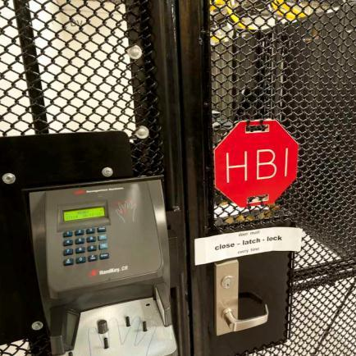
Service security starts with physical datacenter
Cameras
24x7 security staff
Barriers
Fencing
Alarms
Two-factor access control: Biometric readers and card readers
Security operations center
Seismic bracing
Days of backup power
Perimeter
Building
Computer room
Notes:
Slide title: Service security starts with physical datacenter
Slide objectives: Explain how infrastructure security starts with the physical security of datacenters – the perimeter, the building itself, the computer room – coupled with extensive, 24x7 monitoring.
Slide script:
Microsoft datacenters employ controls at the perimeter, building, and computer room with increasing security at each level, utilizing a combination of technology and traditional physical measures.
Our datacenters, managed CLICK. Security starts at the perimeter with camera monitoring, security officers, physical barriers, and fencing.
CLICK. At the building, seismic bracing, and extensive environmental protections protect the physical structure and integrated alarms, cameras, and access controls (including two-factor authentication via biometrics and smart cards) govern access. The systems are monitored 24x7 from the operations center.
CLICK. Similar access controls are used at the computer room, which also has redundant power.
by Microsoft Global Foundation Services (GFS), are audited to ensure the controls we have in place are being rigorously adhered to.
One important thing to note is that datacenter personnel do not have access to the data that resides on the servers housed there. They are only responsible for the care of the hardware, network, and power. They cannot login to the servers. Management of the Azure platform is done from a central operations center on Microsoft’s campus.

Slide 16
Architected for secure multi-tenancy
Azure:
Centrally manages the platform and isolates customer environments using the Fabric Controller
Runs a configuration-hardened version of Windows Server as the Host OS
Uses Hyper-V Windows Server 2012 R2 – a battle tested and enterprise proven hypervisor
Runs Windows Server on guest VMs for platform services
Customer:
Manages their environment through service management interfaces and subscriptions
Chooses from the gallery or brings their own OS for their Virtual Machines
Customer
admin
Microsoft Azure
Portal
Smart API
Customer 1
Customer 2
Guest VM
Guest VM
Guest VM
Fabric
Controller
Hypervisor
Host OS
End
users
Azure storage
SQL Database
Notes:
Slide title: Architected for secure multi-tenancy
Slide objective: The Fabric Controller (FC) functions as the kernel of the Azure platform, managing resources as needed. The FC provisions, stores, delivers, monitors, and commands the VMs and physical servers that make up the Azure customer environment and infrastructure.
Slide Script:
Azure is architected for secure multi-tenancy. It’s designed to abstract much of the infrastructure that typically underlies applications (servers, operating systems, web and database software, and so on), so that developers can focus on building applications – and not on managing resources. The goal is to provide a secure, consistent, scalable set of resources for each customer that they can manage through a subscription created through www.windowsazure.com and associated with a Microsoft account or organizational account. A set of Azure technologies isolate each customer’s environment from others:
The Fabric Controller is the central brain that secures and isolates customer environments by sending commands to the Host OS and the Hypervisor.
The Host OS is a configuration-hardened version of Windows Server.
The Hypervisor is Hyper-V from Windows Server 2012, which has been battle-tested and proven in enterprise environments worldwide.
The Guest VM OS can be either Windows Server or chosen and supplied by the customer. (Customer-controlled VMs are called guest VMs, and the guests that run on them are the guest OS).

Slide 17
Firewall protection
INTERNET
Client
Microsoft Azure
Azure:
Controls access from the Internet, permits traffic only to endpoints, and provides load balancing and NAT at the Cloud Access Layer
Isolates traffic and provides intrusion defense through a distributed firewall
Defines access controls between tiers and provides additional protection via the OS firewall
Customer:
Applies corporate firewall using site-to-site VPN
Cloud Access Layer
443
Customer 1
Virtual Network
Corp Firewall
443
VPN
Application Tier
Logic Tier
Database Tier
Notes:
Slide title: Firewall protection
Slide objective: Describe the benefits and key components of firewall protection.
Slide script:
Azure is designed with firewall protection at the cloud access layer, OS level, and private network level with the ability to apply corporate firewall using site-to-site VPN.
AZURE:
Controls access from the Internet, permits traffic only to endpoints, and provides load balancing and NAT at the Cloud Access Layer
Isolates traffic and provides intrusion defense through a distributed firewall
Defines access controls between tiers and provides additional protection via the OS firewall
CUSTOMER:
Applies corporate firewall using site-to-site VPN

Slide 18
Patch management
Azure:
Applies regularly scheduled updates to the platform
Releases critical patches immediately
Rigorously reviews and tests all changes
Customer:
Applies similar patch management strategies for their Virtual Machines
Monthly MSRC patch review
Patching rollout
Scanning
Audit validation
Monitor 100,000+ vulnerability reports
Sourced from customers & worldwide network of security researchers
Prioritize critical updates
Monthly OS releases with patches
Scanning & reporting of all Azure VMs
Track & remediate any findings
Reconciliation report
Resolution summary
Notes:
Slide title: Patch management
Slide objectives: Describe how Microsoft Azure works with MSRC to identify when patch releases are required, and applies patches immediately or during a scheduled release to the Microsoft Azure environment based on the severity of the vulnerability.
Slide script:
Security patches help protect systems from known vulnerabilities. Integrated deployment systems manage the distribution and installation of security updates for the Azure service. Customers can apply similar update management processes for Virtual Machines (VMs) deployed on Azure.
AZURE:
Microsoft Azure works with MSRC to identify when patch releases are required and applies patches immediately or during a scheduled release to the Microsoft Azure environment based on the severity. Microsoft Azure is notified by the Microsoft Security Response Center (MSRC) and Microsoft Online Security Services & Compliance (OSSC) teams upon identification of updates applicable to Azure environment. This includes the notification of the latest patches released. Microsoft Azure works with MSRC and evaluates patch releases to determine applicability and impact to the Microsoft Azure environment and customers. The applicable security patches are released through the periodic OS release cycle in accordance with change and release management procedures. Emergency out-of-band security patches (e.g., Software Security Incident Response Process (SSIRP) patches) are expedited for more immediate release.
The patches are automatically applied to the customers’ Guest VMs unless the customer has configured the VM for manual upgrades. In this case, the customer is responsible for patching.
Microsoft Azure follows a change process to modify the underlying OS within the platform. All changes are reviewed and tested, at a minimum, for their quality, performance, impact on other systems, recovery objectives and security features before they are moved into production using the Microsoft Azure Release process. Microsoft Azure has established test windows for reviewing and testing of new features, changes to existing features and patches.
CUSTOMERS:
Customers apply patches to their Virtual Machines using Systems Center or whatever other processes they use on-premises.

Slide 19


Monitoring and logging
Microsoft Azure
Enable Monitoring Agent
Customer VMs
Azure:
Performs monitoring and alerting of security events for the platform
Enables security data collection via Monitoring Agent or Windows Event Forwarding
Customer:
Configures monitoring
Exports events to SQL Database, HDInsight, or a SIEM for analysis
Monitors alerts and reports
Responds to incidents
Portal
Smart API
Guest VM
Guest VM
Cloud Services
Events
Azure Storage
HDInsight
Customer
Admin
Extract event information to SIEM or other Reporting System
SIEM Admin View
Event ID | Computer | Event Description | Severity | DateTime
1150 | Machine1 | Example security event | 4 | 04/29/2014
2002 | Machine2 | Signature Updated Successfully | 4 | 04/29/2014
5007 | Machine3 | Configuration Applied | 4 | 04/29/2014
1116 | Machine2 | Example security event | 1 | 04/29/2014
1117 | Machine2 | Access attempted | 1 | 04/29/2014
Alerting & reporting
Notes:
Slide title: Anti-virus & anti-malware
Slide objective: Describe the benefits and key components of anti-virus & anti-malware protection.
Slide script:
Centralized monitoring, correlation, and analysis systems manage the large amount of information generated by devices within the Azure environment, providing continuous visibility and timely alerts to the teams that manage the service. Additional monitoring, logging, and reporting capabilities provide visibility to customers.
AZURE:
Performs monitoring & alerting of security events for the platform
Enables security data collection via Monitoring Agent or Windows Event Forwarding
CUSTOMER:
Configures monitoring
Exports events to SQL Database, HDInsight, or a SIEM for analysis
Monitors alerts & reports
Responds to incidents

Slide 20
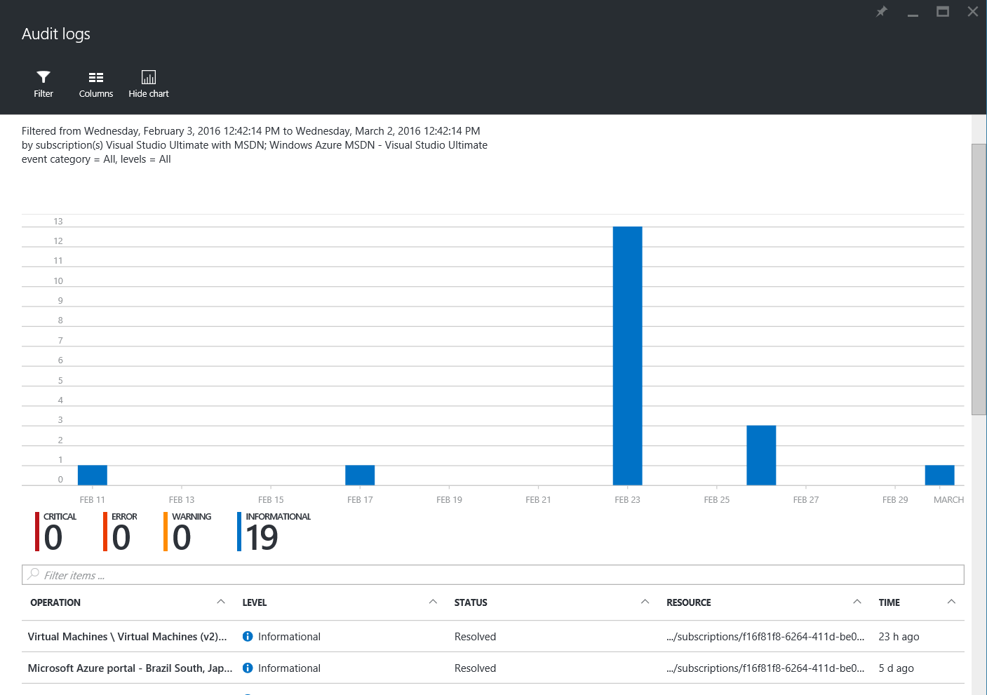
Azure Activity Logs
Change Management logs for subscription
Add/remove/modify
Retained for 90 days
Can drill down in portal
Can export to Storage Account or Event Hub for SEIM
Can maintain for 1-365 days, or forever

Slide 21
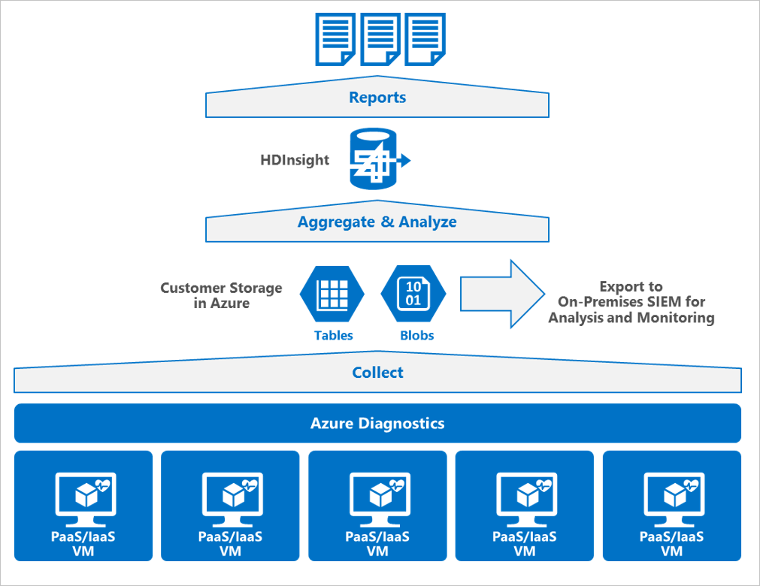
Security data collection with Azure Diagnostics

Slide 22
Antivirus/antimalware
Microsoft Azure
Enable & configure
antimalware
Azure:
Performs monitoring and alerting of antimalware events for the platform
Enables real-time protection, on-demand scanning, and monitoring via Microsoft Antimalware for Cloud Services and Virtual Machines
Customer:
Configures Microsoft Antimalware or an AV/AM solution from a partner
Extracts events to SIEM
Monitors alerts & reports
Responds to incidents
Customer VMs
Portal
Smart API
Guest VM
Guest VM
Cloud Services
Azure Storage
Events
Customer
Admin
Extract Antimalware Health Events to SIEM or other Reporting System
SIEM Admin View
Event ID | Computer | Event Description | Severity | DateTime
1150 | Machine1 | Client in Healthy State | 4 | 04/29/2014
2002 | Machine2 | Signature Updated Successfully | 4 | 04/29/2014
5007 | Machine3 | Configuration Applied | 4 | 04/29/2014
1116 | Machine2 | Malware Detected | 1 | 04/29/2014
1117 | Machine2 | Malware Removed | 1 | 04/29/2014
Alerting & reporting
Notes:
Slide title: Antivirus & antimalware
Slide objective: Describe the benefits and key components of antivirus & antimalware protection.
Slide script:
Antimalware helps protect the platform from viruses, malware, spyware, and other malicious software and customers can enable antimalware for their applications and infrastructure in Azure.
AZURE:
Performs monitoring & alerting of security events for the platform. Azure also scans all software components (including OS) deployed to Azure for malware as part of our internal build and deployment.
Enables real-time protection, on-demand scanning, and monitoring via Microsoft Antimalware for Cloud Services and Virtual Machines
CUSTOMER:
Configures Microsoft Antimalware or an AV/AM solution from a partner
Extracts events to SIEM
Monitors alerts & reports
Responds to incidents
For added assurance, VMs can be routinely reimaged to clean out intrusions that may have gone undetected

Slide 23
Threat detection
INTERNET
End users
THREAT DETECTION: DOS/IDS Layer
Azure:
Provides big data analysis of logs for intrusion detection and prevention for the platform
Employs denial of service attack prevention measures for the platform
Regularly performs penetration testing
Customer:
Can add extra layers of protection by deploying additional controls, including web application firewalls
Conducts penetration testing of their applications
Microsoft Azure
Cloud Access & Firewall Layer
Customer Environment
Virtual Network
DOS/IDS Layer
Application Tier
Corp 1
VPN
DOS/IDS Layer
Logic Tier
DOS/IDS Layer
Database Tier
Notes:
Slide title: Threat detection
Slide objective: Provide an overview of how Microsoft Azure provides threat detection.
Slide script:
Intrusion detection and DDoS attack prevention are employed to help mitigate threats from outside the system as well as attacks staged by other customers.
AZURE:
Provides big data analysis of logs for intrusion detection & prevention for the platform. If anomalous activity is detected, teams are notified and threats mitigated through the incident response process discussed earlier.
Employs denial of service attack prevention measures for the platform. Azure uses standard detection and mitigation techniques such as SYN cookies, rate limiting, and connection limits to protect against DDoS attacks.
Regularly performs penetration testing
CUSTOMER:
Can add extra layers of protection by deploying additional controls, including web application firewalls from partners like Barracuda Networks’ Web Application Firewall
Conducts penetration testing of their applications

Slide 24



Forensics
Azure:
Provides coordination, analysis of logs and VHD images in the event of platform-level incident
Customer:
Contacts Microsoft for forensic data when needed
Uses standard security response and forensics processes
Notes:
Slide title: Forensics
Slide objectives: Describe how Azure provides the forensic ability to track incidents after the fact and track them to their root-cause.
Slide script:
In the event of a security incident, Microsoft Azure forensic tools can help identify and mitigate threats. Customers can reduce the need to invest in these capabilities on their own and benefit from economies of scale in Microsoft datacenter infrastructure. Microsoft Azure provides coordination of forensic analysis, evaluation of logs, and VHD images in the event of platform-level incident. Azure also works with customers to provide log data to help them respond to threats. It is the customer’s responsibility to conduct further forensic analysis and coordinate with law enforcement as necessary.
AZURE:
Provides coordination, analysis of logs, and VHD images in the event of platform-level incident
CUSTOMER:
Contacts Microsoft for forensic data when needed
Uses standard security response and forensics processes

Slide 25

Identity and access
Microsoft employee access management
Enterprise cloud identity – Azure AD
Monitor and protect access to cloud apps
Multi-factor authentication
Notes:
Slide title: Identity & access
Slide objectives: Provide an overview of Microsoft Azure identity & access.
Slide script:
Microsoft has strict controls that restrict access to Azure by Microsoft employees. Azure also enables customers to control access to their environments, data, and applications. Microsoft offers comprehensive and federated identity and access management solutions for customers to use across Microsoft Azure and other services such as Office 365, helping them simplify the management of multiple environments and control user access across applications.
Enterprise cloud directory. Microsoft Azure Active Directory is a comprehensive identity and access management solution in the cloud. It combines core directory services, advanced identity governance, security, and application access management. Microsoft Azure Active Directory makes it easy for developers to build policy-based identity management into their applications. Microsoft Azure Active Directory Premium includes additional features to meet the advanced identity and access needs of enterprise organizations.
Access monitoring and logging: Security reports are used to monitor access patterns and to proactively identify and mitigate potential threats. Microsoft administrative operations, including system access, are logged to provide an audit trail if unauthorized or accidental changes are made. Customers can turn on additional access monitoring functionality in Microsoft Azure and use third-party monitoring tools to detect additional threats. Customers can request reports from Microsoft that provide information about user access to their environments.
Strong authentication. Microsoft Azure multi-factor authentication reduces organizational risk and helps enable regulatory compliance by providing an extra layer of authentication, in addition to a user’s account credentials, to secure employee, customer, and partner access. Microsoft Azure multi-factor authentication can be used for both on-premises and cloud applications.

Slide 26
Microsoft employee Access Management
Just in time &
role-based access
Pre-screened admin requests access
Microsoft Azure
BLOBS
TABLES
QUEUES
DRIVES
Leadership grants
temporary privilege
Microsoft Corporate Network
No standing access to the platform and no access to customer Virtual Machines
Grants least privilege required to complete task
Multi-factor authentication required for all administration
Access requests are audited and logged
Notes:
Slide title: Microsoft employee access management
Slide objectives: Describe how Microsoft controls employee access to Microsoft Azure customer environments.
Slide script:
Access to customer data by Microsoft operations and support personnel is denied by default. When granted (requires leadership approval), access is carefully managed and logged. The access control requirements are established by Microsoft Azure Security Policy:
No access to customer data by default
No user/administrator accounts on customer VMs
Logging and monitoring when local accounts are created on VMs
Microsoft Azure support personnel are assigned unique Corporate AD accounts by Microsoft as part of the standard new employee onboarding process. Microsoft Azure Access Control SOP was reviewed by BSI in the course of Microsoft Azure ISO 27001 certification. Microsoft Azure relies on Microsoft Corporate Active Directory, managed by MSIT, to control access to key information systems. Multi-factor authentication is required, and access is only granted from secure consoles.
All access attempts are monitored and can be displayed via a basic set of reports.

Slide 27
Enterprise cloud identity – Azure AD
Azure:
Provides enterprise cloud identity and access management
Enables single sign-on across cloud applications
Offers multi-factor authentication for enhanced security
Customer:
Centrally manages users and access to Azure, Office 365, and hundreds of pre-integrated cloud applications
Builds Azure AD into their web and mobile applications
Can extend on-premises directories to Azure AD through synchronization
Azure
Active Directory
Cloud Apps
End users
Active Directory
Notes:
Slide title: Identity management
Slide objectives: Describe how Azure provides services that will maintain consistent identity and roles-based policies to integrate with a customer’s on-premises infrastructure
Slide script:
Azure Active Directory is a comprehensive identity and access management solution for the cloud that provides a robust set of capabilities to manage users and groups and help secure access to applications including Microsoft online services, like Office 365 and a world of non-Microsoft SaaS applications. It combines core directory services, advanced identity governance, and application access management. Azure Active Directory also offers a rich standards-based platform that enables developers to deliver access control to their applications, based on centralized policy and rules.
AZURE:
Provides enterprise cloud identity and access management
Enables single sign-on across cloud applications
Offers multi-factor authentication for enhanced security
CUSTOMER:
Centrally manages users and access to Azure, O365, and hundreds of pre-integrated cloud applications
Builds Azure AD into their web and mobile applications
Can extend on-premises directories to Azure AD through synchronization

Slide 28
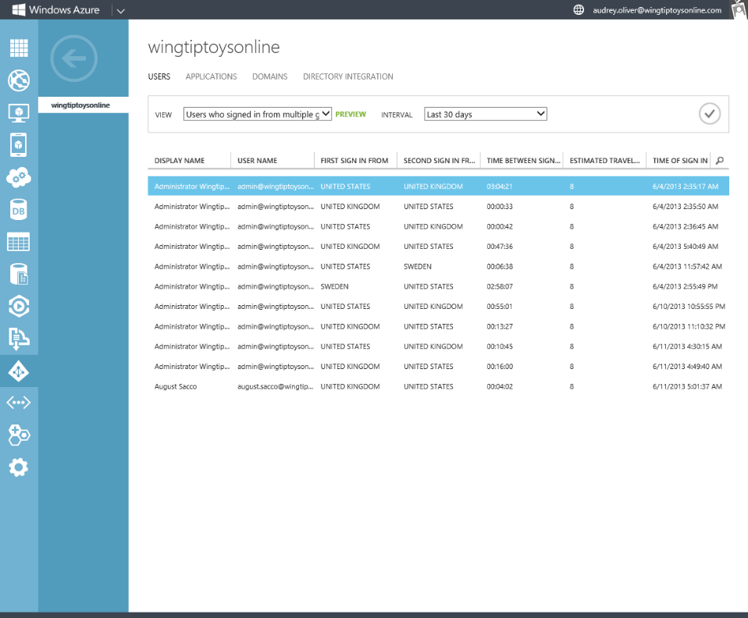
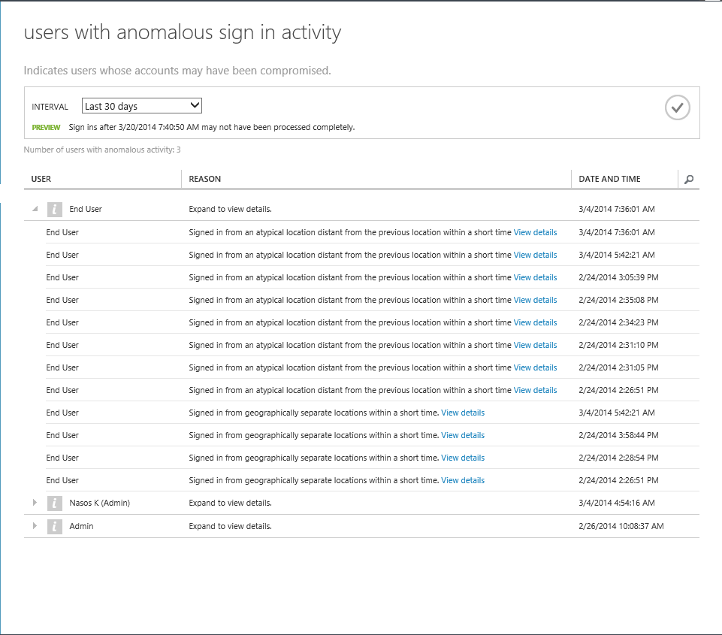
Monitor and protect access to cloud apps
User
Non-user
Azure:
Uses encrypted password hashes for synchronization
Offers security reporting that tracks inconsistent traffic patterns, including:
Sign-ins from unknown sources
Multiple failed sign-ins
Sign-ins from multiple geographies in short timeframes
Sign-ins from suspicious IP addresses and suspicious devices
Customer:
Reviews reports and mitigates potential threats
Can enable multi-factor authentication
XXXXX
XXXXX
XXXXX
Notes:
Slide title: Monitor & protect access to enterprise apps
Slide objectives: Describe how Azure monitors & helps protect access to enterprise apps.
Slide Script: Windows Azure Active Directory offers built in security features.
AZURE:
Uses encrypted password hashes for synchronization, which means that we do not store user passwords for synchronized scenarios.
Offers security reporting that tracks inconsistent traffic patterns, including:
Sign-ins from unknown sources
Multiple failed sign-ins
Sign-ins from multiple geographies in short timeframes
Sign-ins from suspicious IP addresses and suspicious devices
CUSTOMER:
Reviews reports and mitigates potential threats
CLICK. Can enable multi-factor authentication

Slide 29



Incident response
DevOps engaged
Security Team
engaged
Event detected
Incident Assessment
Event
start
Security event confirmed
Customer notification
Customer process
step 1
Determine affected customers
Determine customer impact
Azure customer
notification
In-depth 9 step incident response process
Focus on containment and recovery
Make contractual commitments regarding customer notification
Notes:
Slide title: Incident response
Slide objective: Explain how Microsoft operates a global 24x7 event and incident response team to help mitigate threats from attacks and malicious activity.
Slide script:
The security controls and risk management processes Microsoft has in place to secure the cloud infrastructure reduce the risk of security incidents, but in the event an incident occurs, the Security Incident Management (SIM) team within the Microsoft Online Security Services & Compliance (OSSC) team is ready 24 hours a day, every day, to respond. SIM’s mission is to quickly and accurately assess and mitigate computer security incidents involving Microsoft's Online Services, while managing the necessary internal and customer communications.
When events are detected, a 9 step process is kicked off that focuses first on containment and recovery. Customer notification is a key part of this process.

Slide 30

Data protection
Data encryption options
Data segregation
Data location and redundancy
Data destruction
Notes:
Slide title: Data protection
Slide objectives: Provide an overview of Microsoft Azure data protection.
Slide script:
Both technological safeguards, such as encrypted communications, and operation processes help keep customer data secure. Customers have the flexibility to implement additional encryption and manage their own keys.
Data in transit. Microsoft Azure uses industry-standard transport protocols such as SSL and TLS between user devices and Microsoft datacenters, and within datacenters themselves. With virtual networks, customers can use industry standard IPsec protocol to encrypt traffic between their corporate VPN gateway and Microsoft Azure. Customers can enable encryption for traffic between their own VMs and end users.
Data at rest. Customers are responsible for ensuring that data stored in Microsoft Azure is encrypted in accordance with their standards. Windows offers a wide range of encryption capabilities up to AES-256, giving customers the flexibility to choose the solution that best meets their needs. Options include .NET cryptographic services, Windows Server public key infrastructure (PKI) components, Microsoft StorSimple cloud-integrated storage, Active Directory Rights Management Services (AD RMS), and BitLocker for data import/export scenarios.
Control over data location. For many customers, knowing and controlling the location of their data can be an important element of data privacy compliance and governance. Microsoft Azure customers can specify the geographic areas where their customer data is stored. Data may be replicated within a geographic area for redundancy, but will not be transmitted outside it. For more information, including exceptions to this policy, see the Microsoft Azure Trust Center.
Data segregation. Microsoft Azure is a multi-tenant service, meaning that multiple customers’ deployments and Virtual Machines are stored on the same physical hardware. Microsoft Azure uses logical isolation to segregate each customer’s data from that of others. This provides the scale and economic benefits of multitenant services while rigorously preventing customers from accessing one another’s data.
Data destruction. When customers delete data or leave Microsoft Azure, Microsoft follows strict standards for overwriting storage resources before reuse, as well physically destruction of decommissioned hardware.

Slide 31

Encryption in transit
Azure:
Encrypts most communication between Azure datacenters
Encrypts transactions through Azure Portal using HTTPS
Supports FIPS 140-2 ciphers
Customer:
Can choose HTTPS for REST API (recommended) for storage
Configures HTTPS endpoints for application running in Azure
Encrypts traffic between Web client and server by implementing TLS on IIS
Azure
datacenter
Azure
Portal
Azure
datacenter
Notes:
Slide title: Encryption in transit
Slide objective: Explain how Azure encrypts specific types of communications in transit.
Slide script:
Azure uses encryption to help secure communications between and within datacenters and from customers. Customers can configure communications using SSL and TLS.
AZURE:
Encrypts most communication between Azure datacenters with a commitment to encrypt all traffic by the end of 2014
Encrypts transactions through Azure Portal using HTTPS
Only accepts encrypted disks for import/export of data
Supports FIPS 140-2 ciphers
CUSTOMER:
Can choose HTTPS for REST API (recommended) for storage
Configure HTTPS endpoints for application running in Azure
Encrypt traffic between web client and server by implementing TLS on IIS

Slide 32



Encryption at rest
Virtual Machines
BitLocker
Virtual Machines:
Data drives – Azure Disk Encryption using BitLocker
SQL Server – Transparent data encryption
Files & folders – EFS in Windows Server
Storage:
Storage Service encryption
BitlLocker encryption of drives for import/export of data
StorSimple with AES-256 encryption
Applications:
Client-side encryption through .NET Crypto API
RMS SDK for file encryption by your applications
SQL TDE
Partners
EFS
Storage
BitLocker
StorSimple
Applications
.NET Crypto
RMS SDK
Notes:
Slide title: Encryption in rest
Slide objective: Explain how Azure encrypts specific types of information at rest.
Slide script:
Customers are responsible for ensuring that data stored in Azure is encrypted in accordance with their standards. Azure offers a wide range of encryption capabilities up to AES-256, giving customers the flexibility to choose the solution that best meets their needs.
Virtual Machines:
Data drives – Full disk encryption through BitLocker
Boot drives – Partner solutions
SQL Server – Transparent data encryption
Files & folders – EFS in Windows Server
Storage:
Bitlocker encryption of drives for import/export of data
StorSimple with AES-256 encryption
Applications:
Client Side encryption through .NET Crypto API
RMS SDK for file encryption by your applications
Provides defense-in-depth against:
Offline attacks
Online attacks when keys are used as a secondary AuthZ mechanism
Encryption at-rest is required by certain sovereign laws and certifications e.g. PCI/DSS and HIPPA
Control
Customers can choose if and when data is encrypted
Customers can choose what encryption keys are used and where they are stored
Customers can decide at anytime to revoke access to the keys and data
Transparency
Customers have full visibility to the encryption state of their data
Customers know at any time where their data is stored
Customers have the ability to view logs at any time related to the stored data and keys

Slide 33
Encryption models
Encryption models
Server Encryption |  |  | Client Encryption
Server-side encryption using service managed keys | Server-side encryption using customer managed keys in Azure Key Vault | Server-side encryption using on-premises customer managed keys
Azure services can see decrypted data Microsoft manages the keys Full cloud functionality | Azure services can see decrypted data Customer controls keys via Azure Key Vault Full cloud functionality | Azure services can see decrypted data Customer controls keys on-premises Full cloud functionality | Azure services cannot see decrypted data Customer keep keys on-premises REDUCED cloud functionality

Slide 34
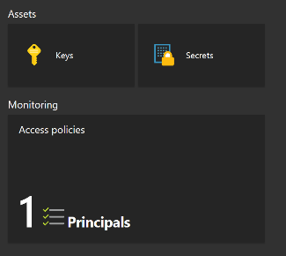
What is Azure Key Vault?
An Azure resource provider that lets you:
Store and manage SECRETS, KEYS and CERTIFICATES
Control Authentication and Authorization
Backed by hardware security modules
All secrets and keys are protected at rest with key chain terminating in HSMs
Keys marked as ‘HSM-protected’ are protected even at runtime with HSMs
Key Vault ≠ customer’s dedicated HSM
Azure Key Vault is a multi-tenant service backed by Microsoft-managed HSMs
Azure uses Thales HSMs
Notes:
Key Vault
Azure Key Vault helps safeguard cryptographic keys and secrets used by cloud applications and services. By using Key Vault, you can encrypt keys and secrets (such as authentication keys, storage account keys, data encryption keys, .PFX files, and passwords) by using keys that are protected by hardware security modules (HSMs). For added assurance, you can import or generate keys in HSMs. If you choose to do this, Microsoft processes your keys in FIPS 140-2 Level 2 validated HSMs (hardware and firmware).
Your own container to store and manage related SECRETS and KEYS
Typically you create one Key Vault per application instance
You can create up to 800 Key Vaults per Azure subscription
Secrets like BitLocker Encryption Keys [BEK] or Linux PassPhrase are stored protected in customer control in customer Key Vault container
Secrets are encrypted by customer controlled Key Encryption Key [KEK – RSA 2048] where KEK is specified
Customer grants explicit Read/Write access to their Key Vault container to Azure to enable disk encryption
Azure does not have ANY default access to customer Key Vault for disk encryption feature

Slide 35
Securing your Vault
Management Plan |  | Data Plane
Authorization through…
Role Based Access Control (RBAC) |  | Key Vault Access Policy
SCOPE TO Subscription Resource Group Azure Resource | ASSIGN WITH Portal PowerShell Azure CLI Rest API | AFFECTED OBJECTS Keys Secrets Certificates | Template Options Or Specific operations per Key Secret Certificate Application
Authentication through Azure Active Directory
Notes:
Access to a key vault is controlled through two separate interfaces: management plane and data plane.
For both planes proper authentication and authorization is required before a caller (a user or an application) can get access to key vault.
Authentication establishes the identity of the caller, while authorization determines what operations the caller is allowed to perform.
For authentication both management plane and data plane use Azure Active Directory.
For authorization, management plane uses role-based access control (RBAC) while data plane uses key vault access policy.
When you create a key vault in an Azure subscription, it is automatically associated with the subscription's Azure Active Directory tenant. All callers (users and applications) must be registered in this tenant to access this key vault. An application or a user must authenticate with Azure Active Directory to access key vault. This applies to both management plane and data plane access. In both cases, an application can access key vault in two ways:+
user+app access - usually this is for applications that access key vault on behalf of a signed-in user. Azure PowerShell, Azure Portal are examples of this type of access. There are two ways to grant access to users: one way is to grant access to users so they can access key vault from any application and the other way is to grant a user access to key vault only when they use a specific application (referred to as compound identity).
app-only access - for applications that run daemon services, background jobs etc. The application's identity is granted access to the key vault.
Azure Key Vault is an Azure service available via Azure Resource Manager deployment model. When you create a key vault, you get a virtual container inside which you can create other objects like keys, secrets, and certificates. Then you access your key vault using management plane and data plane to perform specific operations. Management plane interface is used to manage your key vault itself, such as creating, deleting, updating key vault attributes and setting access policies for data plane. Data plane interface is used to add, delete, modify, and use the keys, secrets, and certificates stored in your key vault.
The management plane and data plane access controls work independently. For example, if you want to grant an application access to use keys in a key vault, you only need to grant data plane access permissions using key vault access policies and no management plane access is needed for this application. And conversely, if you want a user to be able to read vault properties and tags, but not have any access to keys, secrets, or certificates, you can grant this user, 'read' access using RBAC and no access to data plane is required.

Slide 36
Disk Encryption

Slide 37
Azure Disk Encryption
What:
Disk encryption for Windows and Linux IaaS VMs
Key management integrated in customer Key Vault using HSM
Value proposition:
VMs are secured at rest using industry standard encryption technology to address organizational security and compliance requirements
VMs boot under customer controlled keys and policies and they can audit their usage in Key Vault
Threats addressed:
Data breach → Loss of disks, loss of storage account keys

Slide 38
Azure Disk Encryption scenarios
Keys/Secrets are protected in customer Key Vault
Encryption scenarios
New VMs from customer-encrypted VHDs
New VMs from Azure Gallery
Running VMs in Azure
OS (boot) volume
Data volume
IaaS VM
Azure Storage
Protection elements
Access control: Customer control access to the keys/secrets in their Key Vault
Monitoring and logging: Customer collect logs in their storage account
Data security and availability: Disks are stored encrypted in customer storage account and are automatically replicated by Azure Storage

Slide 39
Storage encryption
Server-side encryption – Service encrypts data automatically
Scenario: Customer needs compliance check box checked, no need to modify applications
Support for Block Blobs, Append Blobs, and Page Blobs
Storage account level (ARM accounts only) setting for enabling encryption
Client-side encryption – Encrypt data in your applications
Scenario: Customer want to encrypt data within their client applications prior to sending to Azure
Support for Blob Storage, Table Storage, and Queue Storage

Slide 40
Azure Security Center

Slide 41
Azure Security Center
Prevent
Monitors the security state of your Azure resources
Defines policies for your Azure subscriptions based on your company’s security requirements, the types of applications that you use, and the sensitivity of your data
Uses policy-driven security recommendations to guide service owners through the process of implementing needed controls
Rapidly deploys security services and appliances from Microsoft and partners
Detect
Automatically collects and analyzes security data from your Azure resources, the network, and partner solutions like antimalware programs and firewalls
Leverages global threat intelligence from Microsoft products and services, Digital Crime and Incident Response Centers, and external feeds
Applies advanced analytics, including machine learning and behavioral analysis
Respond
Provides prioritized security incidents/alerts
Offers insights into the source of the attack and impacted resources
Suggests ways to stop the current attack and help prevent future attacks

Slide 42
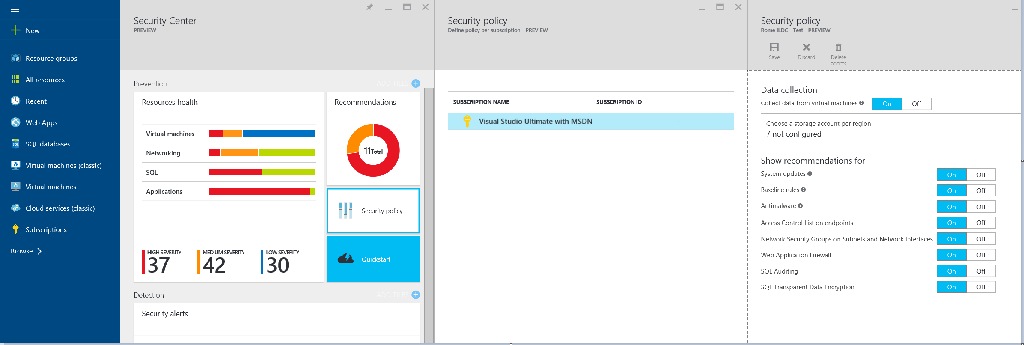
Security policies
Define policies at the subscription or resource group level

Slide 43
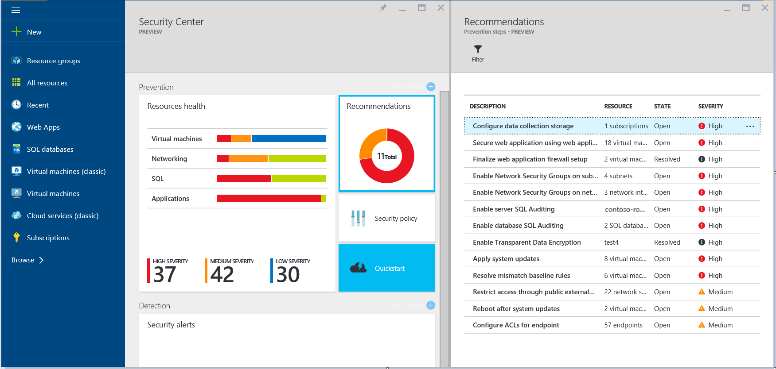
Security recommendations
Security Center analyzes the security state of your Azure resources to identify potential security vulnerabilities

Slide 44
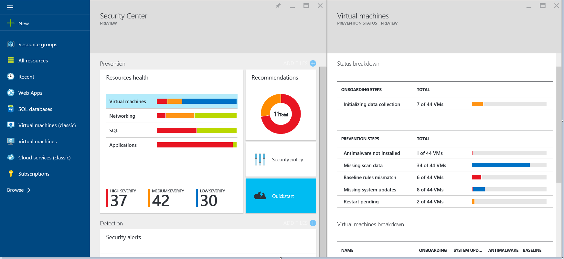
Monitor resource health
Shows the overall security posture of the environment by resource type, including Virtual Machines, Virtual Networks, Azure SQL, Database and ARM IaaS web applications

Slide 45
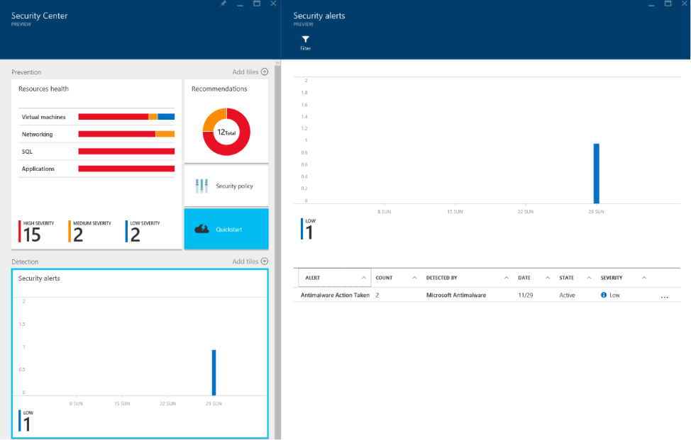
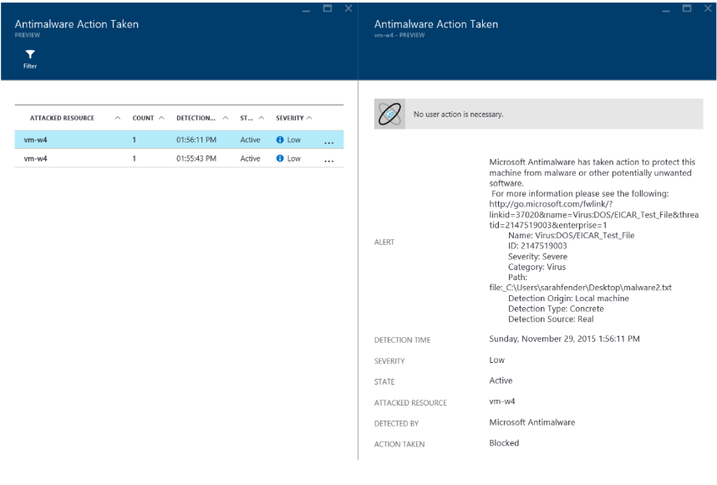
Security alerts
Automatically collect, analyze, and integrate log data from your Azure resources, the network, and partner solutions like antimalware programs and firewalls
Notes:
Compromised Virtual Machines communicating with known malicious IP addresses
Advanced malware detected by using Windows error reporting
Brute force attacks against Virtual Machines
Security alerts from integrated antimalware programs and firewalls

Slide 46
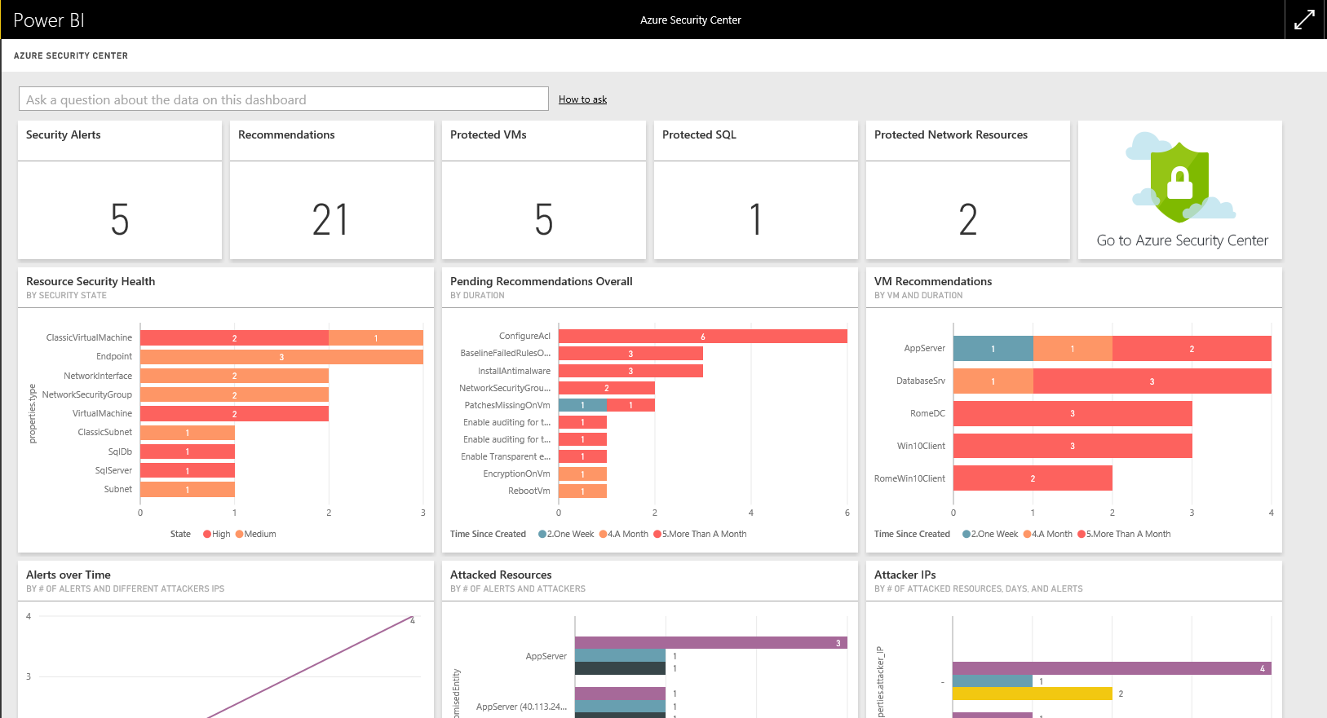
Analyze with Power BI
The Power BI Dashboard for Azure Security Center enables you to visualize, analyze, and filter recommendations and security alerts from anywhere

Slide 47
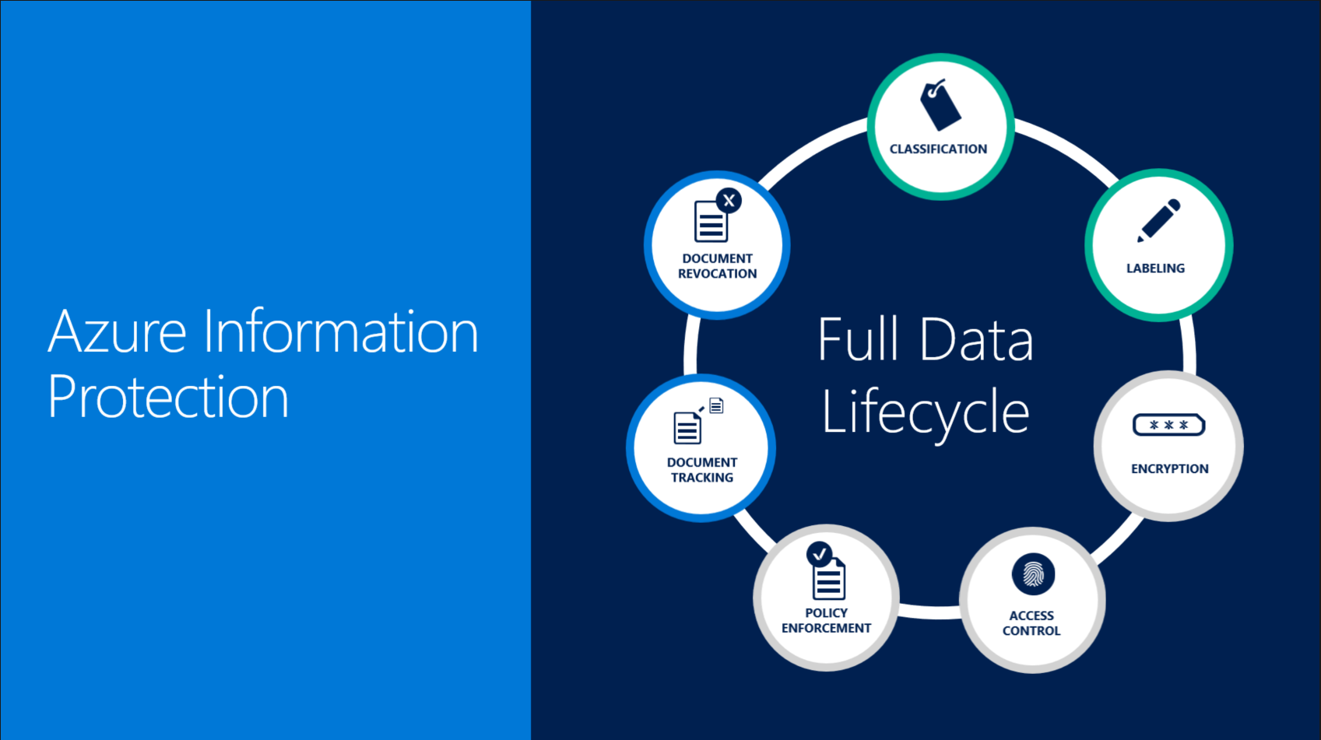

Slide 48
What is Azure Information Protection (AIP)?
Formerly known as…
Azure RMS, Azure Active Directory Rights Management, AD RMS & more!
But leverages Azure RMS
Definition
Cloud Based Solution, uses encryption, identity, and authorization policies
Classify, label and protect documents and emails
Automatically or manually
Labels and Classification
Once labeled, classification identifiable at all time
Includes visual markings e.g. headers, footers, watermarks
Adds metadata to files and email headers for other services to leverage
AIP FAQ
Notes:
AIP
Does "Azure Information Protection" now replace all these names?
As the cloud-based solution that you purchase, yes. Azure Information Protection offers the new capabilities of classification and labeling for an organization's documents and emails, which in turn can apply Rights Management protection.
However, Azure Rights Management is still used as the protection technology for Azure Information Protection, and for Office 365 services that use this cloud-based Rights Management protection. So in the context of the protection technology that is used by Azure Information Protection, "Azure Rights Management" (Azure RMS) remains a current name.
Azure Information Protection is a cloud-based solution that helps an organization to classify, label, and protect its documents and emails. This can be done automatically by administrators who define rules and conditions, manually by users, or a combination where users are given recommendations.
How labels apply classification
You use Azure Information Protection labels to apply classification to documents and emails. When you do this, the classification is identifiable at all times, regardless of where the data is stored or with whom it’s shared. The labels include visual markings such as a header, footer, or watermark. Metadata is added to files and email headers in clear text so that other services (such as data loss prevention solutions) can identify the classification and take appropriate action. +
For example, the following email message has been classified as "Internal". This label is added as a footer to the email message, as a visual indicator for all recipients that it's intended for internal use and should not be sent outside the organization. This label is also embedded in the email headers so that email services can inspect this value and could create an audit entry or prevent it from being sent outside the organization.
https://docs.microsoft.com/en-us/information-protection/get-started/faqs

Slide 49

Classify Data – Begin the Journey
Classify data based on sensitivity
Start with the data that is most sensitive
IT can set automatic rules; users can complement it
Associate actions such as visual markings and protection
IT admin sets policies,
templates, and rules
SECRET
CONFIDENTIAL
PERSONAL
INTERNAL
NOT RESTRICTED
Notes:
SPEAKER NOTES
Get reference to this slide from
https://techreadytv.com/TR24/session?sCode=EMS300

Slide 50
Classification Best Practices
Keep labels simple and limited in number
Align terminology that matches the users mental model
Consider external sharing needs
Define a default label for documents (maximizes adoption)
Always allow reclassification
Notes:
SPEAKER NOTES
Get reference to this slide from
https://techreadytv.com/TR24/session?sCode=EMS300

Slide 51
Azure security strategies

Slide 52
Azure security strategies – Risks
The following are the primary sources for new or increased risks when moving to the cloud
Risk 1: Availability of administrative interfaces to the public Internet
The key security difference of an IaaS solution hosted in Azure is that the administrative interfaces are potentially accessible through public Internet interfaces while a typical on-premises virtualization deployment may be restricted to only a corporate Intranet or to a dedicated management VLAN
Risk 2: Potential inadvertent exposure of intranet services to the public Internet (IaaS workloads)
This risk is specific to publicly hosted IaaS workloads that are transitioned to Microsoft Azure. If not configured correctly post-migration, a Virtual Machine may accept traffic from the Internet for remote management including remote desktop and PowerShell
This allows attackers to attempt to connect and authenticate to these resources, enabling them to abuse or test stolen credentials as well as to attempt dictionary attacks or brute force attacks on the Virtual Machine passwords

Slide 53
Rapid Azure onboarding security Start with ‘do no harm’
When planning security for rapidly onboarding to Azure, organizations should take a “do no harm” approach to ensure that security risks are not increased when compared to the current on-premises posture for the organization.
Risk mitigation strategies:
Establish administrative standard and practices
Set multi-factor authentication
Harden administrative workloads
Ensure logging
Establish an administrative model
Set logon restrictions
Educate the administration
Framework for response and recovery processes

Slide 54
Building a containment strategy
A containment strategy should focus on containing propagation of risk at all feasible levels while prioritizing operational effectiveness and protection of assets by business impact.
Strategy Elements
Security zones
Minimize number of zone
Establishment of zone infrastructure (identity systems, etc.) and associated bounded roles
Isolation between security zones
Containment within a security zone
Containment within a host (between users and administrators)
Containment within an application (as applicable)
Securing of inter-zone trust boundary including network and security infrastructure as well as threat modelling any application/data flows across that trust boundary
Notes:
Containment within the zone should focus on protecting administrative control of assets in the security zone and ensuring that least privilege is applied to access of business sensitive assets.

Slide 55
Key decisions

Slide 56
Follow up required on anything below?
What is most important to you to Discuss?
Compliance requirements
Your Top security concerns?
Security Concerns with Azure?
Questions or security concerns with any particular Azure Services?
Notes:
PRESENTER NOTES
This SAW is typically an overview to provide assurance to the customer. Refer to the Statement of Work for this delivery to see if there are any specific requirements or delivery to be performed around security.
This topic will often stir up many security concerns, so there are often follow ups required to simply provide more assurance to support the customer’s concerns. This can come from research support on your part, bringing in additional Security SMEs or Architects if necessary to support, and finally if there are still unanswered questions, then possible support from the Product Group may be required to address deeper concerns that may impact the overall delivery of the project.

Slide 58
Note about the Appendix
These are extra slide for your review
They have been removed from the presentation to streamline it and to allow completion of this deck within 1-2 hours
Use for studying and or supporting any other discussions on this topic if needed with the customer.
DELETE THIS SLIDE BEFORE DELIVERY

Slide 59
Appendix

Slide 60

Encryption components
Azure Key Vault
Azure Active Directory
Customer owned
Service owned
Key Encryption Keys (KEK)
Data Encryption Keys (DEK)
Resource Providers

Slide 61
Azure Key Vault concepts
Secrets | Keys
Any sequence of bytes < 25 KB e.g. Connection string, Storage account key, PFX file | A cryptographic key RSA 2048
Use pattern: Operator adds secret to Key Vault App reads secret and uses it | Use pattern: Operator adds key to Key Vault App asks Key Vault service to decrypt/sign with the key. Keys cannot be read back
Key Vault
Your own container to store and manage related SECRETS and KEYS
Typically you create one Key Vault per application instance
You can create up to 800 Key Vaults per Azure subscription

Slide 62
Containment and segmentation strategies – traditional approaches and challenge
Traditionally, many IT security organizations have built segmentation and containment strategies primarily using firewalls that filter IP traffic by protocol and port rules
These designs typically include a production intranet, an extranet (sometimes called a “demilitarized zone” (DMZ)) extranet, and sometimes additional segment isolation within or outside of production using firewalls
The net result of most of these is a failed strategy that is difficult to implement, costly to the organization, and yet repeatedly proven easily evaded by attackers and penetration testers

Slide 63
KeyVault
Read/write/use via REST API / SDK / PSH / CLI
https://Vault1.vault.azure.net
https://Vault1.vault.azure.net/secrets/MySQLPassword
https://Vault1.vault.azure.net/secrets/MySQLPassword/e0ec2eb3b8764192aa1e7f20fc74dab7
https://Vault1.vault.azure.net/keys/MyKey
https://Vault1.vault.azure.net/keys/MyKey/fc8ae52ae7544ff38c60243f1c1bb129

Slide 64



Abstract Model
Workload
Workload encrypts data locally
DEK = Data Encryption Key
Workload asks Key Vault to encrypt DEKs
HSM in Key Vault protects KEK
KEK = Key Encryption Key
BYOK prevents KEK from seeing daylight
Decryption is exact opposite sequence
Data1
Data2
Data3
DEK1
DEK2
DEK3
DEK1
DEK2
DEK3
(DEK1)_{KEK}
(DEK2)_{KEK}
(DEK3)_{KEK}
HSM
KEK

Slide 65
Key management – Service-managed keys
Pros
Simple setup (checkbox)
Microsoft is responsible for key rotation, backup and redundancy
Cons
No control over the key (spec, lifecycle, revocation)
Same root key may be used to encrypt multiple customers
No ability to segregate key management from service management
Customer owned
Service owned

Slide 66
Key management – Customer-managed keys
Pros
Full control over the keys used
Ability to encrypt multiple services to one master
Can segregate key management from service management
Can define service and key location across regions
Cons
Full responsibility for key access management
Full responsibility for key lifecycle management
Setup
Customer owned
Service owned

Slide 67






Azure Disk Encryption – Encrypted VHD workflow
Encrypted Disks
Customer uploads Encrypted VHD to their Azure Storage account
Customer provision encryption key material* in their Key Vault and grants access to platform to provision VM
Customer opt into enabling disk encryption
Azure service management updates service model with encryption and Key Vault configuration
Azure platform provision encrypted VM
* Key Material – BitLocker Encryption Keys [Windows], Passphrase [Linux]
Virtual Machine
Azure Storage
Provision encrypted VM
Read VHD
Read Key
Customer Key Vault
AAD
HOST
AAD token
Encryption Config
Customer Disks
Service Management
ARM/PS cmdlets

Slide 68
Azure Disk Encryption – New VM or running VM workflow
Encrypted Disks
Customer opt into enabling disk encryption
Customer provide identity and other encryption configuration to Azure Portal/API to provision encryption key material* in their Key Vault
Azure service management updates service model with encryption and Key Vaultconfiguration and Azure platform push the encryption extension on the VM
Encryption extension initiate encryption on the VM
VM is encrypted
* Key Material – BitLocker Encryption Keys [Windows], Passphrase [Linux]
Virtual Machine
Azure Storage
Upload Key
Encryption Extension
AAD token
Customer Key Vault
HOST
AAD
Encryption Extension
Encryption Config
Service Management
ARM/PS cmdlets

Slide 69
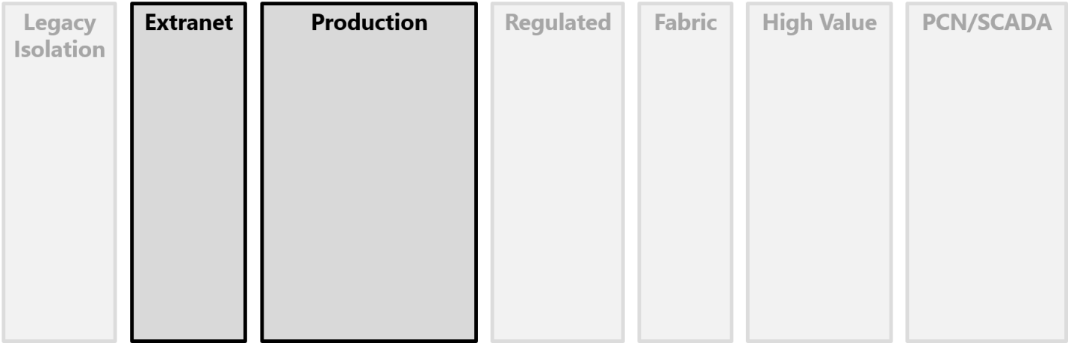
Isolation between security zones
Design security zones to minimize the number of application data flows across the trust boundaries between zones.
Every inter-zone trust boundary must be secured and defended and each application that crosses the boundary incurs security overhead to analyze, protect, and monitor.
Perform a threat modelling exercise for every system and application data flows that crosses the trust boundary between zones, particularly focusing on:

Slide 70
SYSC Section 8 – 11 Requirements of outsourcing setup
Requirement | Microsoft capability
1. Ability and capacity of service provider | SLAs for Azure services 20+ years experience of running cloud services Secure development lifecycle and assume breach simulation Independent audits 24x7 support and incident response service
2. Mechanism to assess performance levels | Service Health Dashboard Service Delivery Manager to review performance regularly Audit results available under NDA Management/monitoring technologies - Systems Centre, Operational/Application Insights Datacentre tours available on request
3. Supervise and manage risk of outsource | Secure development lifecycle and assume breach simulation Independent audits Service Delivery Manager to review performance regularly Microsoft Regulatory Compliance Program
4. Appropriate actions plans if non performant | Microsoft Alerts via Service Health Dashboard and emails Post incident reports shared and Service Delivery Manager as single point of contact Financially backed SLAs EU Model Clauses and EU/Swiss Safe Harbor compliance
5. Retain skills to supervise | Regular reviews with Service Delivery Manager Premier Support for Azure Cloud Solution Architect to provide technical best practices for Azure Microsoft training courses and workshops
6. Disclosure of material impact | Proactive informing of Service Impacting Events via email and Service Health Dashboard Customer informed of any breach promptly
Notes:
Secure Development Lifecycle – Company-wide, mandatory development process that embeds security into every phase of development process.
Assume Breach Simulation – Dedicated security expert “red team” that simulate real-world attacks at network, platform, and application layers, testing the ability of Azure to detect, protect against, and recover from breaches.

Slide 71
SYSC Section 8 – 11 Requirements of outsourcing setup
Requirement | Microsoft Capability
7. Ability to terminate | Customer has rights to terminate and extract/delete data at any time Hybrid capabilities allows movement back to on premises Microsoft confirm that all data will be deleted from the entire service
8. Co-operate with regulator & other authorities | Wide range of certifications and accreditations Audit results available under NDA Microsoft Regulatory Compliance Program Regulator Right to Examine clause
9. Right to inspect | Regulator Right to Examine clause Microsoft Regulatory Compliance Program
10. Protect confidential information | Microsoft doesn’t use customer data for advertising Restricted and transparent data access – e.g. troubleshooting or when required by law Data access is controlled, logged and revoked as soon as no longer needed Customers choose data location and replication options Flexibility around encrypting data in transit and at rest Deletion of data on customer request and on contract termination Disks destroyed according to NIST standards Role-based access control to support authorisation based on user’s role
11. Disaster Recovery | SLAs for Azure services Availability sets to build highly available applications Data redundancy options across multiple geographic regions Various technology options such as Azure Backup and Site Recovery Service Delivery Manager and Cloud Solution Architect to provide technical best practices
Notes:
Secure Development Lifecycle - Company-wide, mandatory development process that embeds security into every phase of development process.
Assume Breach Simulation – Dedicated security expert Red Team that simulate real-world attacks at network, platform, and application layers, testing the ability of Azure to detect, protect against, and recover from breaches.

Slide 72
Financial Services Addendums
Through the “Regulator Right to Examine,” Microsoft will provide the Regulator:
The opportunity to communicate with Microsoft’s auditor at customer’s expense
If required by the Regulator, a direct right to examine the Online Services, including examination on-premises and access to information, records, reports and documents relating to the Online Services
Through the “Microsoft Regulatory Compliance Program,” Microsoft will provide RBS with:
Ad hoc engagement with Microsoft Product Group
Early access to future compliance related information
One-on-one discussions with Microsoft’s auditors
Annual Microsoft webcast of ISO and SSAE audit reports
Option to view service control framework
Opportunity to recommend additions to audit scope of service
Reports on external penetration testing
Review of service risk register and other in-depth aspects
Notes:
The Microsoft Regulatory Compliance Program
This optional, fee-based program extends the compliance functionality of the standard Office 365, Azure, or Dynamics CRM service to provide deeper, ongoing engagement with Microsoft through:
Ad hoc access to additional information from Microsoft subject matter experts (SMEs) – for instance, participants can ask questions or seek help or clarification about the standard service documentation.
Access to additional compliance-related information that Microsoft may develop over time – such as customer FAQs, compliance summits, or documents that provide insights into the underpinnings and plans for the compliance features of the Office 365, Azure, or Dynamics CRM service.
The opportunity for one-to-one discussions with Microsoft third-party auditors, if required.
Participation in an annual, webcast walkthrough of ISO and SSAE audit reports with Microsoft SMEs. A recording of this webcast will also be made generally available.
The option to view the Microsoft control framework for the service. This can enable a customer’s risk officers to better understand and assess the scope and coverage of the framework (the service is subject to more than 600 controls), and to suggest additional controls, if needed.
The opportunity to recommend future additions to the audit scope of the service. All participants will be allowed to suggest new audit controls; the program’s Financial Services Executive Committee (composed of one program participant from each regulatory region) will agree on up to five controls for inclusion in future audits.
Access to detailed reports of the external annual penetration tests conducted on the service.
The option to review the service risk register, to assess overall service approach to risk management and the underlying risks associated with using the service.

Slide 73
Security standardization for administrative control
Maintaining the security standards of a system is a critical to maintaining positive administrative control of that system.
Getting positive enterprise control requires restricting all means of administrative. The following are categories for control for the identity store:
Operating system – Technical control of any operating system (OS) through means such as management agents, local administrative group membership, and local configurations.
Active Directory and identity data – Technical control of any data in Active Directory or other identity system(s) that provides control of the identity system or other entities.
Operational practices – Operational practices or actions can provide technical control of assets such as password and credential handling practices, where administrative credentials are used to logon, and the physical security of computing assets.

Slide 74
Security standardization for administrative control
The security of software developed in house relies on the security practices during the development cycle as well as the maintenance and response process
All custom developed applications should be developed with a full security development lifecycle to minimize risk
All in-house applications should be threat modelled to systematically identify risk and mitigations to the applications design and configuration

Slide 75
Security strategy decisions
In order to establish a full security strategy when implementing solutions in or consuming services from Microsoft Azure, the following considerations should apply:
Establish the “do no harm” controls outlined in the models section
Ensure to follow each of the customer responsibilities for security in a cloud enabled world outlined here: https://technet.microsoft.com/en-us/library/dn919927(v=office.15).aspx
Educate the organization’s security staff with knowledge of Azure capabilities and security features
Integrate Azure Logs with current security tools such as Security Information and Event Management (SIEM)

Slide 76
Security strategy decisions
In order to establish a security operations for Microsoft Azure through administrative controls, practices and procedures, the following considerations apply:
All personnel with subscription admins accounts will have a separate dedicated administrative account workstations. This account will be used only for administrative tasks and the standard user account will have no administrative privileges
All subscription admins will utilize Azure multi-factor authentication (MFA) except for one emergency access account, if used
All subscription admin accounts will only logon to authorized administrative workstations with those admin accounts. Subscription admin accounts will never be used on any other workstation

Slide 77
Security strategy decisions
Standard user accounts associated with administrative personnel may be used anywhere standard user accounts are permitted to logon
Administrative workstations will not be used for email or general web browsing, only administration of Azure and other on premises resources as appropriate
Administrative personnel may use virtualization (such as Hyper-V) or remote desktop to access an alternate operating system to perform standard user tasks such as web browsing and email
Subscription admins will check administrative logs for anomalies each day at a minimum, ideally every time they logon
All subscription admin accounts should be restricted by ADFS policy to only be authenticated from authorized administrative workstations
An emergency access account will be created and the password for the account will be physically secured. The password will be changed on each use and the account should be configured for Azure multi-factor authentication (MFA). If this is not created, emergency access will be provided through Azure support processes

Slide 78
Red Team vs. Blue Team - Summary
Red Teaming makes theoretical scenarios real by exposing gaps in security, exploiting live vulnerabilities, and providing concrete evidence of the need to assume breach
This challenging world – the Blue Team exercises the ability to detect and respond in the face of attacks
All organizations can benefit from adopting similar security strategies for combatting emerging and evolving threats
Microsoft Enterprise Cloud Red Teaming: http://go.microsoft.com/fwlink/?linkid=518599&clcid=0x409

Slide 79
Data segregation
Storage isolation:
Data accessible only through claims-based IDM and access control with private key
Storage blocks are hashed by the hypervisor to separate accounts
SQL isolation:
SQL Database isolates separate account databases
Network isolation:
VM switch at the host level blocks inter-tenant communication
Customer
Admin
Microsoft Azure
Portal
Smart API
Customer 1
Customer 2
Guest VM
Guest VM
Guest VM
Fabric
Controller
Hypervisor
Host OS
End
users
Azure Storage
Access
control
SQL Database
Notes:
Slide title: Data segregation
Slide objective: Explain how storage, SQL, and networks are isolated to segregate data.
Slide script:
Microsoft Azure uses logical isolation to segregate each customer’s data from that of others. This provides the scale and economic benefits of multitenant services while rigorously preventing customers from accessing one another’s data.
Storage isolation:
Data accessible only through claims-based IDM and access control with a Storage Access Key (SAK). Shared Access Signature (SAS) tokens can be generated using storage access keys to provide more granular, restricted access. Storage access keys can be reset via the Microsoft Azure Portal or SMAPI.
Storage blocks are hashed by the hypervisor to separate accounts
SQL isolation:
SQL Azure isolates separate account databases
Network isolation:
VM switch at the host level blocks inter-tenant communication

Slide 80
Data location and redundancy
Azure:
Creates three copies of data in each datacenter
Offers geo-replication in a datacenter 400+ miles away
Does not transfer customer data outside of a geo (ex: from US to Europe or from Asia to US)
Customer:
Chooses where data resides
Configures data replication options
Note: Microsoft Azure data centers, Australia – Q2 FY15
Notes:
Slide title: Choice of data location
Slide objective: Explain how Microsoft Azure makes multiple copies of your data in each location – so even if you have your data in one location, you still have 3 different copies.
Slide script:
Microsoft Azure customers can specify the geographic areas where their customer data is stored. Data may be replicated within a geographic area for redundancy, but will not be transmitted outside it. Microsoft Azure replicates data both locally and to different physical locations.
To guard against hardware failures and improve availability, every Blob is replicated across three computers in a Microsoft Azure datacenter.
To ensure more robust backup, Windows offers geo-replicated storage.
Microsoft may transfer customer data within a Geo (e.g., within Europe) for data redundancy or other purposes. For example, Azure replicates Blob and Table data between two regions within the same Geo for enhanced data durability in case of a major datacenter disaster. Microsoft will not transfer customer data outside the geo(s) customer specifies (for example, from Europe to U.S. or from U.S. to Asia) except where necessary for Microsoft to provide customer support, troubleshoot the service, or comply with legal requirements; or where customer configures the account to enable such transfer of customer data.

Slide 81
Data destruction
Immediately removed from primary location
Geo-replicated copy of the data removed asynchronously
Customers can only read from disk space they have written to
Data deletion
Disk handling
Wiping is NIST 800-88 compliant
Defective disks are destroyed at the datacenter
Notes:
Slide title: Data destruction
Slide objective: Explain how when customers delete data or leave Microsoft Azure, Microsoft follows strict standards for overwriting storage resources before reuse, as well physically destruction of decommissioned hardware.
Slide script:
When a customer deletes a Blob or table entity, we immediately delete it from our index used to locate and access the data on the primary location, and then that delete is done asynchronously at the geo-replicated copy of the data. At the primary location, a customer can immediately try to access the Blob or entity and they won’t find it in their index, since we provide strong consistency for the delete. Customers can only read from disk space they have written to. If a customer leaves Azure, we preserve that data for a specified period of time, generally 90 days, before deleting the data.
Microsoft uses NIST compliant disk disposal processes. For hard drives that can’t be wiped we use a destruction process that destroys it (i.e. shredding) and renders the recovery of information impossible (e.g., disintegrate, shred, pulverize, or incinerate). The appropriate means of disposal is determined by the asset type. Records of the destruction are retained. All Microsoft Azure services utilize approved media storage and disposal management services. Paper documents are destroyed by approved means at the pre-determined end-of-life cycle.

Slide 82
Privacy by design
Privacy by design
Restricted data access
and use
Contractual commitments
Privacy controls built into Azure design and operations
Customer data is only used to provide the service and is never used for advertising
Data Processing Agreements, EU Model Clauses, HIPAA BAA
10101010101010101010101010101010
1010101010101010101010101010101010101010101010101010
1010101010101010101010101010
Notes:
Slide title: Privacy by design.
Slide objectives: Provide an overview of privacy by design with Microsoft Azure.
Slide script:
Privacy by Design. With Microsoft, customers can expect Privacy by Design, a policy that guides how Microsoft builds products and services, how services are operated, and how internal teams are organized.
Restricted data access and use. Access to customer data by Microsoft personnel is restricted. Customer data is only accessed when necessary to support the customer’s use of Microsoft Azure. This may include troubleshooting aimed at preventing, detecting, or repairing problems affecting the operation of Microsoft Azure and the improvement of features that involve the detection of, and protection against, emerging and evolving threats to the user (such as malware or spam). When granted, access is carefully controlled and logged. Strong authentication, including the use of multi-factor authentication, helps limit access to authorized personnel only. Access is revoked as soon as it is no longer needed.
No use for advertising. Microsoft Azure does not share customer data with its advertiser-supported services, nor is customer data mined for advertising.
Contractual commitments. Microsoft is unique among major cloud service providers in providing cloud-service-specific privacy statements and making strong contractual commitments to safeguard customer data and protect privacy. Microsoft makes the standard contractual clauses created by the European Union (known as the “EU Model Clauses”) available to enterprise customers to provide additional contractual guarantees concerning transfers of personal data. Recently, Brad Smith announced that Microsoft’s cloud contracts have been validated by European Union data protection authorities as meeting the rigorous privacy standards that regulate companies operating in E.U. member states.

Slide 83
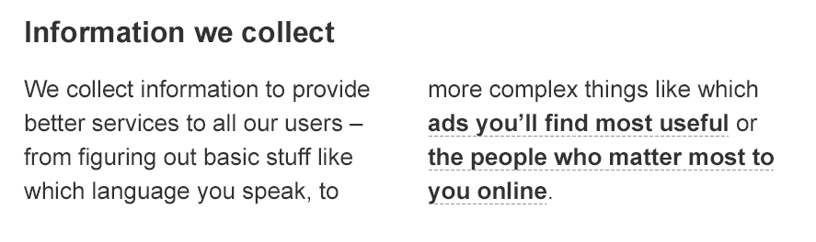



Restricted use
Read the fine print of other cloud service provider’s privacy statements
Azure does not share data with its advertiser-supported services
Azure does not mine customer data for advertising
Notes:
Slide title: Restricted use
Slide objective: Explain how Azure does not share data with its advertiser-supported services and does not mine customer data for advertising.
Slide script:
Microsoft will use the customer data you store in Azure only for purposes consistent with providing you the services. We will not use your customer data or derive information from it for advertising purposes, and we will not sell your customer data.
Azure does not share data with its advertiser-supported services. Azure does not mine customer data for advertising.

Slide 84
Contractual commitments
Microsoft meets high bar for protecting privacy of EU customer data
Microsoft offers customers EU Model Clauses for transfer of personal data across international borders
Microsoft’s approach was approved by the Article 29 committee of EU data protection authorities – the first company to obtain this
EU data privacy approval
Broad contractual scope
Microsoft makes strong contractual commitments to safeguard customer data covered by HIPAA BAA, Data Processing Agreement, & E.U. Model Clauses
Enterprise cloud-service specific privacy protections benefit every industry and region
Notes:
Slide title: Contractual commitments
Slide objective: Explain how Microsoft is unique among major cloud service providers in making strong contractual commitments to safeguard customer data and protect privacy.
Slide script:
We recognize how critical data privacy is to enabling our customers to move to the cloud, and Microsoft has been a pioneer in offering privacy protections for its enterprise cloud services. We were the first to offer contractual commitments for customers subject to the E.U. Data Protection Directive and U.S. HIPAA laws, which call for safeguarding personal data, and have continued to strengthen data privacy through technical, operational, and legal protections.
European Union Approval. Recently, Brad Smith announced that Microsoft’s cloud contracts have been validated by European Union data protection authorities as meeting the rigorous privacy standards that regulate companies operating in E.U. member states. Microsoft has been working closely with the E.U. regulators to allow for the transfer of personal data across borders using its enterprise cloud services, and Microsoft is the first – and so far the only – company to receive joint approval from E.U. Article 29 for its strong contractual commitments to comply with E.U. privacy laws no matter where data is located. This provides additional assurances beyond the Safe Harbor Agreement between the E.U. and U.S, and ensure customers can continue to operate globally if that agreement is changed or suspended.
(For more information, see these resources:
Brad Smith announcement: http://blogs.technet.com/b/microsoft_blog/archive/2014/04/10/privacy-authorities-across-europe-approve-microsoft-s-cloud-commitments.aspx
EU joint approval: http://ec.europa.eu/justice/data-protection/article-29/documentation/other-document/files/2014/20140402_microsoft.pdf)
Contractual scope includes:
Data Processing Agreement that details our compliance with the E.U. Data Protection Directive
E.U. Model Contractual Clauses that provide additional contractual guarantees around transfers of personal data
A HIPAA Business Associate Agreement (BAA) for healthcare entities with access to Protected Health Information (PHI)
Microsoft makes strong contractual commitments to safeguard customer data and has an enterprise cloud-service specific privacy policy: we don’t mingle the privacy commitments of Azure with our other products & ads
These contractual commitments, backed by technical capabilities and operational practices that ensure we can meet on our privacy obligations, benefit customers in every geography and industry. Customers across the globe can use Azure with confidence knowing that Microsoft has met the high bar of privacy protections mandated by these regulations.

Slide 85
Simplified compliance
Information security standards
Effective controls
Government and industry certifications
ISO 27001
SOC 1 Type 2
SOC 2 Type 2
FedRAMP/FISMA
PCI DSS Level 1
UK G-Cloud
Notes:
Slide title: Simplified compliance
Slide objectives: Provide an overview of compliance with Microsoft Azure.
Slide script:
Compliance processes make it easier for customers to achieve their own compliance across multiple services and meet their changing needs efficiently. Together, security-enhanced technology and effective compliance processes enable Microsoft to maintain and expand a rich set of third-party certifications. These help customers demonstrate compliance readiness to customers, auditors, and regulators. As part of its commitment to transparency, Microsoft shares third-party verification results with its customers.
Microsoft Azure is certified for ISO 27001, a broad international information security standard, and undergoes annual audits for ISO compliance. Microsoft Azure has also been audited against the service Organization Control (SOC) reporting framework for SOC 1 Type 2, attesting to the design and operating effectiveness of its controls. In addition, Microsoft Azure has been audited for SOC 2 Type 2, which includes a further examination of Microsoft Azure controls related to security, availability, and confidentiality. Microsoft Azure undergoes annual SOC audits.
Microsoft Azure has also obtained many industry-specific certifications, including:
Payment Card Industry (PCI) Data Security Standard (DSS): Microsoft Azure has been validated for PCI-DSS compliance by an independent Qualified Security Assessor (QSA). Designed to help prevent fraud through increased controls involving credit card data, certification is required for all organizations that store, process, or transmit credit card information. Customers can reduce the complexity of their PCI-DSS certification by using compliant services on Microsoft Azure.
United States FedRAMP: Microsoft Azure has received Provisional Authorization to Operate from the Federal Risk and Authorization Management Program (FedRAMP) Joint Authorization Board (JAB). By achieving this level of federal compliance, Microsoft customers can be assured that its enterprise cloud services have undergone the assessments necessary to verify they meet government security standards.
UK G-Cloud: In the United Kingdom, Azure has been awarded Impact Level 2 (IL2) accreditation, further enhancing Microsoft and its partner offerings on the current G-Cloud procurement Framework and CloudStore.

Slide 86
Security compliance strategy
Business objectives
Industry standards and regulations
Security goals set in context of business and industry requirements
Security analytics and best practices deployed to detect and respond to threats
Benchmarked to a high bar of certifications and accreditations to ensure compliance
Continual monitoring, test and audit
Ongoing update of certifications for new services
Test and audit
Security analytics
Security Compliance
Framework
Security benchmark analysis
Risk management best practices
Certificates and attestations
Notes:
Slide title: Security compliance strategy
Slide objective: Explain how Azure is designed with a compliance strategy that helps customers address business objectives and industry standards & regulations.
Slide script:
Azure is designed with a compliance strategy that helps customers address business objectives and industry standards & regulations. Our security compliance framework includes test and audit phases, security analytics, risk management best practices, and security benchmark analysis to achieve certificates and attestations:
Security goals are set in context of business and industry requirements
Security analytics and best practices are deployed to detect and respond to threats
Benchmarked to a high bar of certifications and accreditations to ensure compliance
Continual monitoring, testing, and auditing
Ongoing updates of certifications and attestations

Slide 87
Certifications and programs
Program | Description
ISO/IEC 27001 | The ISO/IEC 27001:2005 certificate validates that Azure has implemented the internationally recognized information security controls defined in this standard.
SOC 1 SSAE 16/ISAE 3402 | Azure has also been audited against the Service Organization Control (SOC) reporting framework for SOC 1 Type 2 (formerly SAS 70), attesting to the design and operating effectiveness of its controls.
SOC 2 | Azure has been audited for SOC 2 Type 2, which includes a further examination of Azure controls related to security, availability, and confidentiality.
FedRAMP/FISMA | Azure has received Provisional Authorization to Operate from the Federal Risk and Authorization Management Program (FedRAMP) Joint Authorization Board (JAB), having undergone the assessments necessary to verify that it meets FedRAMP security standards.
PCI DSS Level 1 | Azure has been validated for PCI-DSS Level 1 compliance by an independent Qualified Security Assessor (QSA).
UK G-Cloud IL2 | In the United Kingdom, Azure has been awarded Impact Level 2 (IL2) accreditation, further enhancing Microsoft and its partner offerings on the current G-Cloud procurement Framework and CloudStore.
HIPAA BAA | To help customers comply with HIPAA and HITECH Act security and privacy provisions, Microsoft offers a HIPAA Business Associate Agreement (BAA) to healthcare entities with access to Protected Health Information (PHI).
Notes:
Slide title: Certificates & programs
Slide objective: This includes a description of each of the audits, certifications, and programs Microsoft Azure has achieved.
Slide script:
ISO/IEC 27001
Received ISO/IEC 27001:2005 certificate from BSI on 11/29/2011 for Microsoft Azure Core Services; recertified in Dec 2012
Broad international information security standard. Acts as security baseline.
The ISO/IEC 27001:2005 certificate validates that Microsoft has implemented the internationally recognized information security controls defined in this standard.
ISO 27001/27002 (True certification/International Std.)
PCI DSS Level 1
Information security standard designed to prevent fraud through increased controls around credit card data.
SOC 1 / SSAE 16
Successor to SAS 70 attestations.
An accounting standard that is relied upon as the authoritative guidance for reporting on service organizations.
It illustrates Microsoft’s willingness to open up internal security programs to outside scrutiny.
The end result is auditor’s report on the effectiveness and suitability of selected controls to achieve desired control objectives during the period under review. Detailed SSAE 16 report can then be shared with customers under NDA.
Audit report (SOC 1 Type 2) available for Microsoft Azure core services in June 2012.
SOC 2
Azure has been audited for SOC 2 Type 2, which includes a further examination of Azure controls related to security, availability, and confidentiality/
FedRamp/FISMA
Federal Information Security Management Act of 2002 (FISMA) is a U.S. federal law that defines a comprehensive framework to protect government information, operations, and assets against natural and man-made threats.
Required by law for U.S. federal agencies, and looked on favorably by other government agencies.
Azure has received Provisional Authorization to Operate from the Federal Risk and Authorization Management Program (FedRAMP) Joint Authorization Board (JAB), having undergone the assessments necessary to verify that it meets FedRAMP security standards.
PCI DSS
Azure has been validated for PCI-DSS Level 1 compliance by an independent Qualified Security Assessor (QSA).
Customers are responsible for achieving PCI DSS certification for the applications they run in Azure.
A guide is available that details what DSS requirements are fulfilled by Azure and which requirements the customer is responsible for.
UK G-Cloud IL2
‘Protect' level of security for data processing, storage and transmission by UK public sector organization including local and regional government.
Health Insurance Portability and Accountability Act (HIPAA)
Specifies privacy, security, and disaster recovery guidelines for electronic storage of health records.
No platform can be HIPAA compliant; what is needed, though, is Business Associate Agreement (BAA) that enables third parties to build HIPAA compliant applications on Microsoft Azure. We need to sign a BAA with the Covered Entity if Protected Health Information (PHI) they are responsible for is to be stored, processed or otherwise accessed by Azure.
Substantial overlap with ISO controls, i.e., HIPAA program will benefit substantially from ISO work.
HIPAA BAA available for Microsoft Azure core services in June 2012.
Others:
EU-US Safe Harbor Framework
Microsoft (including, for this purpose, all of our U.S. subsidiaries) is Safe Harbor certified with the U.S. Department of Commerce.
This allows for legal transfer of data to Microsoft for processing from within European Union and countries with aligned data protection laws.
Microsoft acts as the data processor and, to the extent of the service’s capabilities, decisions regarding data usage are made by the data controller.
EU Data Protection Directive
Law that sets a baseline for handling personal date in the EU.
US standards meet EU requirements through US Safe Harbor.
Microsoft self-attests compliance under the US Safe Harbor framework, which lets us transfer EU PII outside EU, and even allows the “onward-transfer” from the US to another country.
However, EU regulators and customers increasingly consider the Safe Harbor to be inadequate and are asking for EU Model Contractual Clauses. We currently offer to sign EU MC for WA core services.

Slide 88
Security, privacy, and transparency
Security
Design & operational security
Security lifecycle development
Assume breach simulation
Global incident response
Software update management
Anti-virus/malware protection
Threat management – IDS & DDOS
Privacy
ISO/IEC 27018 & EU Standard Contractual clauses
You own your data – access at any time without notification
Control over where data is stored, transferred and deleted
Restricted data access for Microsoft personnel & subcontractors
Encryption (in-transit & at-rest)
Transparency
Visibility of Azure standards and certifications
Customers control where data is stored
Microsoft doesn’t use customer data for advertising
Notification of law enforcement requests
Security incident notification
Online Services Terms provide details relating to the security and privacy of our Online Services.
Notes:
Contractual commitments - EU model clauses, US-EU Safe Harbor & ISO27018.
Microsoft makes commitments about where data at rest is stored, and designs its online services to use logs to fix issues. If support personnel require access to your core data, for example due to a support call questioning the validity of data items, then this is classified a “data transfer”, as support personnel may be located outside of the EU and viewing a screen with your data on is classified a “data transfer.”
The EU Model Clauses contain commitments to how Microsoft handles these transfers of data in accordance with EU Data Processing Authority regulations.
The letter from the Article 29 Working Party confirms that our incorporation of the clauses should not be seen as ‘ad hoc’ and this diminishes the need to get approval from many local country DPAs for use of the service.
The Online Services Terms has the EU Model Clauses (Processor) embedded within them, including our signature.
Restricted access by Microsoft personnel.
Microsoft restricts access to customer data and datacenter locations on an as needed basis.
For Office 365 and CRM Online, this includes a Lockbox process, where access requests are sent to a manager and are only approved if the request is valid and training and background checks are up to date, and then for a limited period of time.
See Page 11 (Access Controls) of the Online Services Terms.
Notification of lawful requests for information.
Microsoft commits to referring any requests of information back to the customer, and publishes statistics as to the number of requests made and by whom. To date all requests for enterprise customer data have been re-directed to, or satisfied with the knowledge of, the enterprise customer.
See Page 7 of the Online Services Terms.
Control over data location.
Microsoft makes commitments regarding the location of data in geographies for Office 365 and CRM Online.
For Azure, this does depend on the service in question, as some services are distributed geographically (e.g. Azure Active Directory) and some are located in specific geographies only.
See Page 9 of the Online Services Terms.
Data destruction.
Except for free trials, Microsoft will retain customer data stored in the Online Service in a limited function account for 90 days after expiration or termination of customer’s subscription so that customer may extract the data. After the 90 day retention period ends, Microsoft will disable customer’s account and delete the customer data.
See page 4 of the Online Services Terms (Data Retention)
Security incident notification.
Microsoft commits to informing customers promptly/within 30 days if we become aware of any unlawful access to customer data.
See Page 8 (Security Incident Notification) of the Online Services Terms.

